Slide 1
CAMPERS ON MISSION
SOME OF OUR PROJECTS
2014 THRU PRESENT

Slide 2
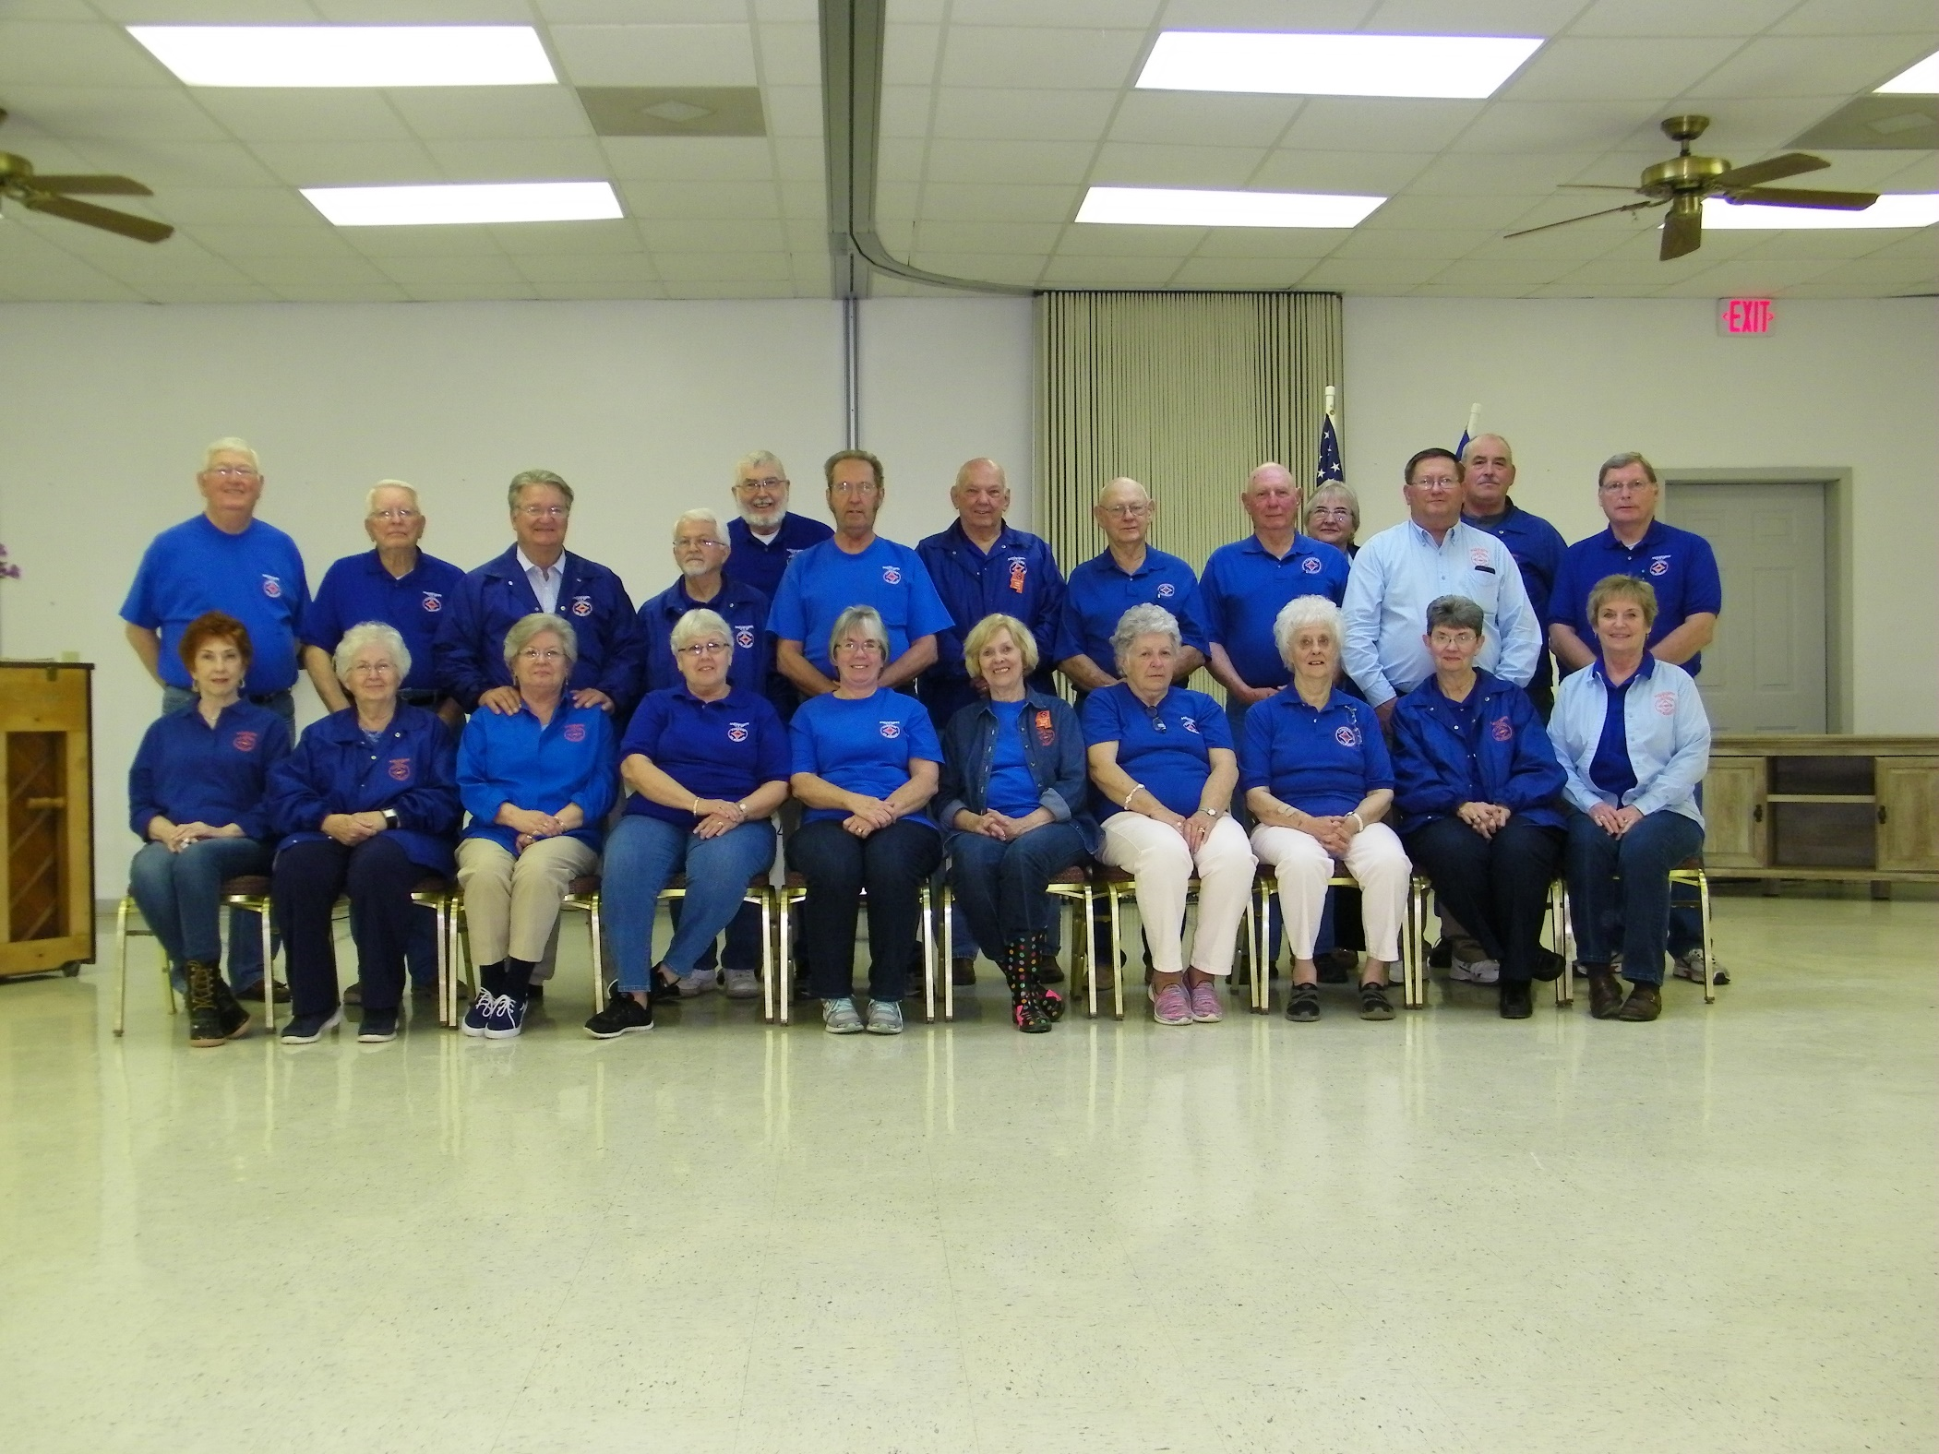
April 2018

Slide 3
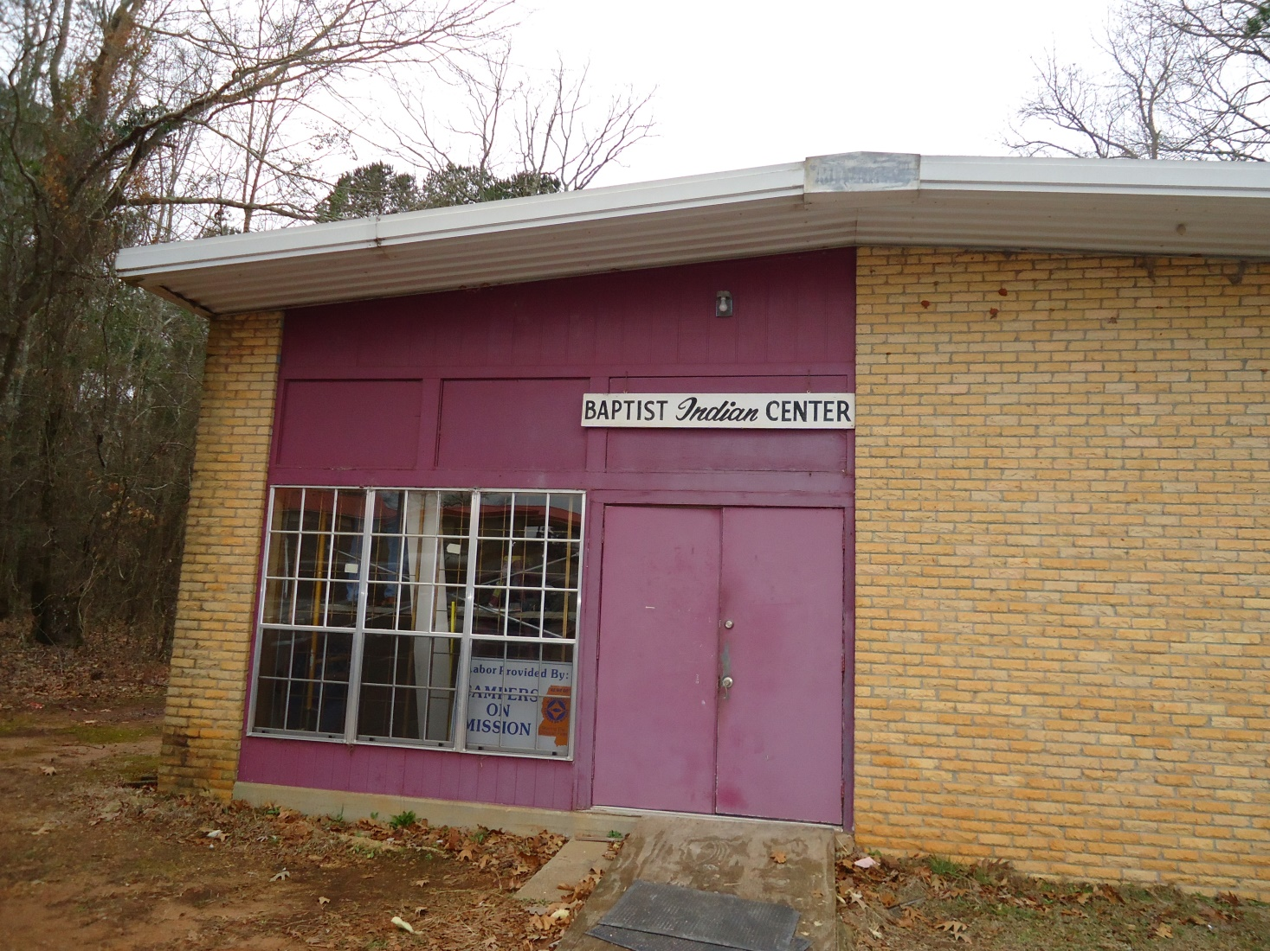

BAPTIST INDIAN CENTER,
PHILADELPHIA, MS
March, 2014
2014

Slide 4
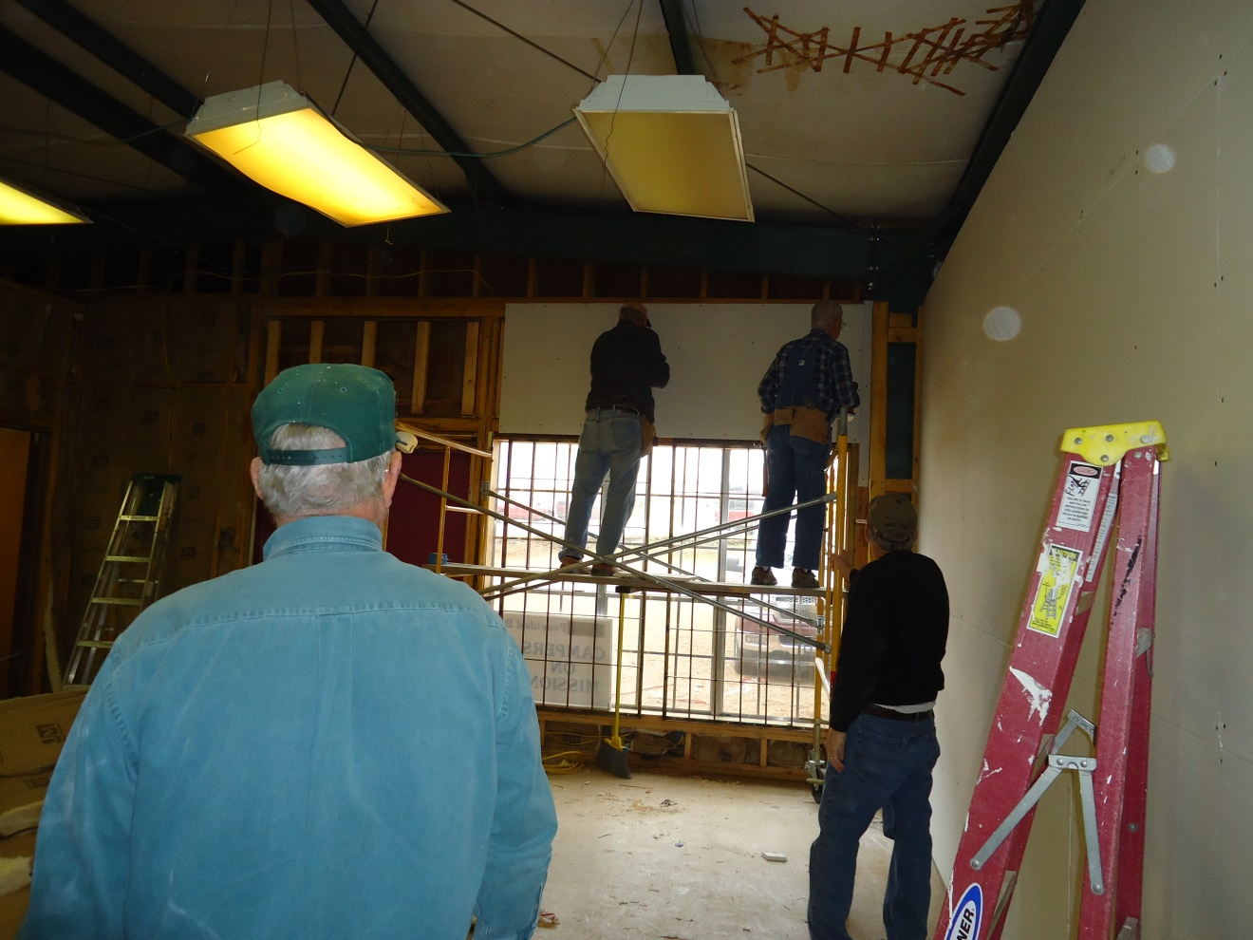

Slide 5
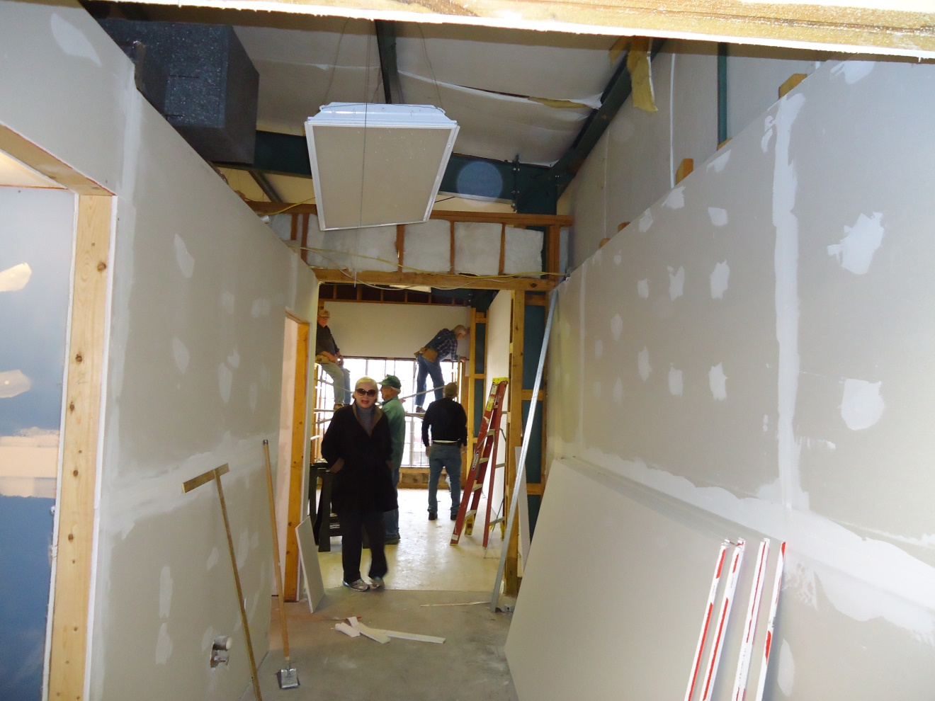

Slide 6
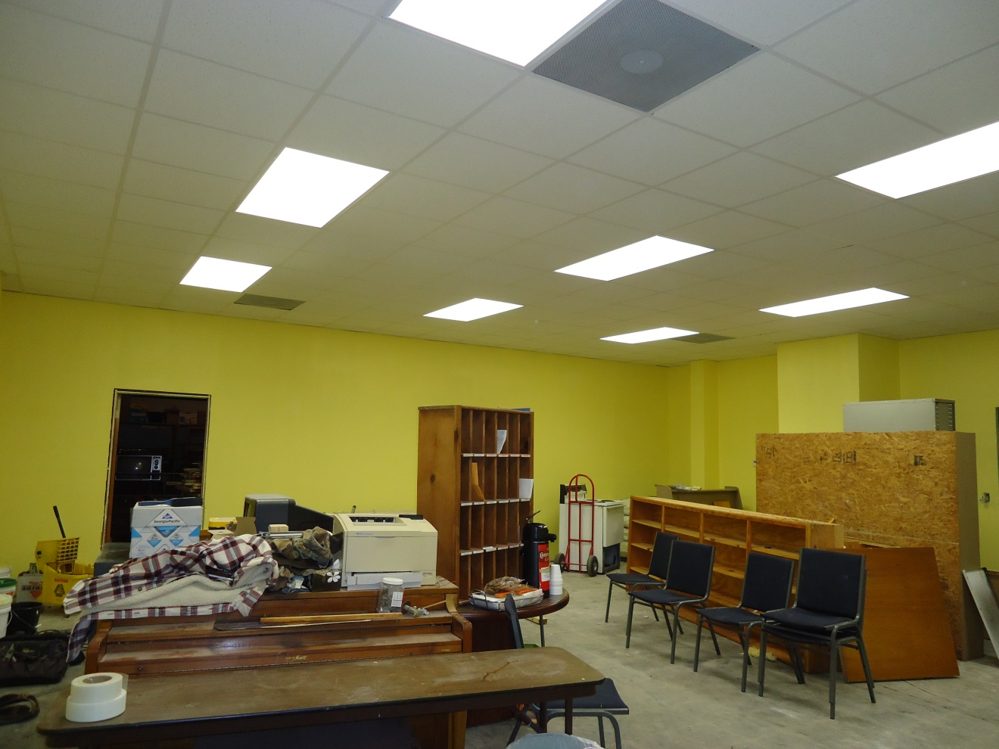

Slide 7
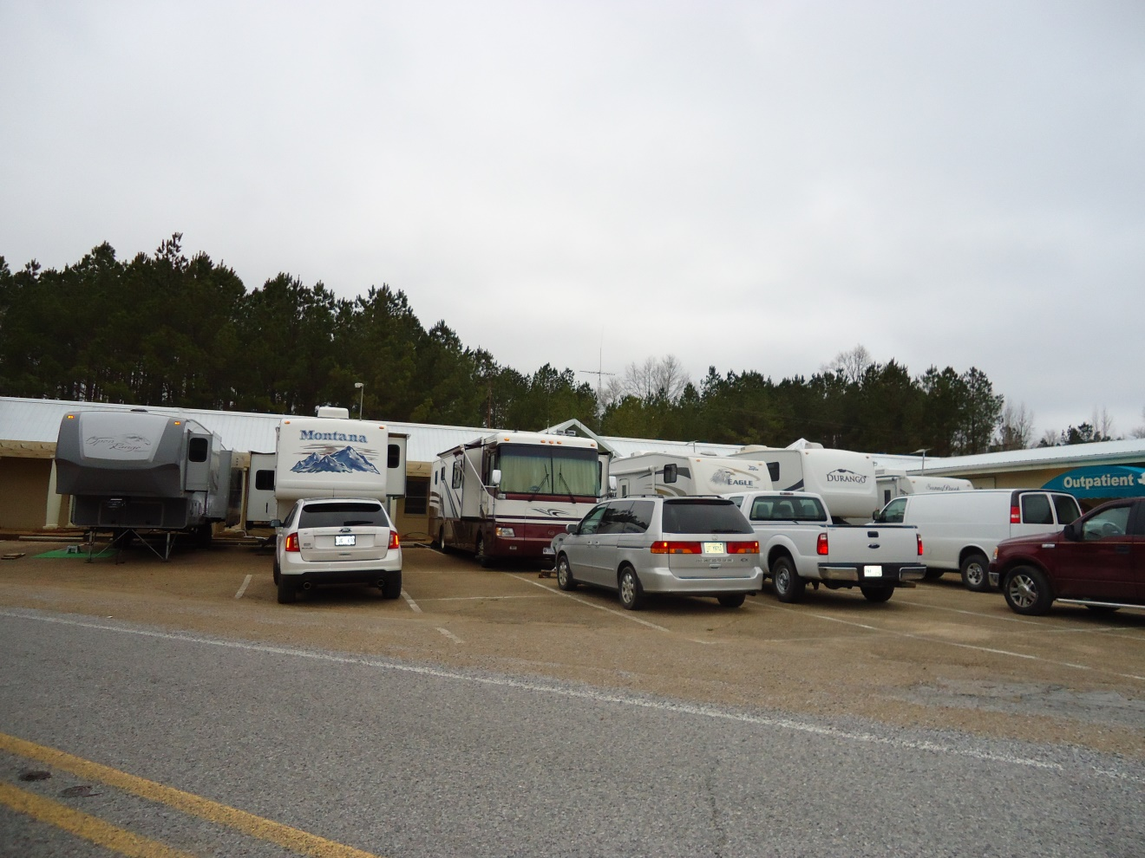

Slide 8
COM-LEAD REVIVAL
FELLOWSHIP BAPTIST CHURCH,
STARKVILLE, MS
APRIL 2014

Slide 9
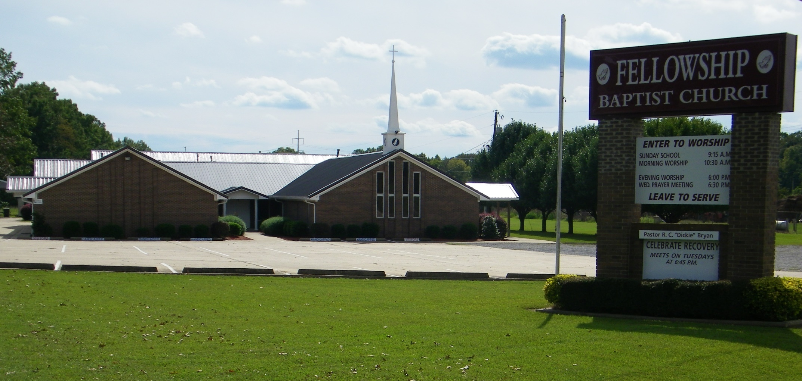

Slide 10
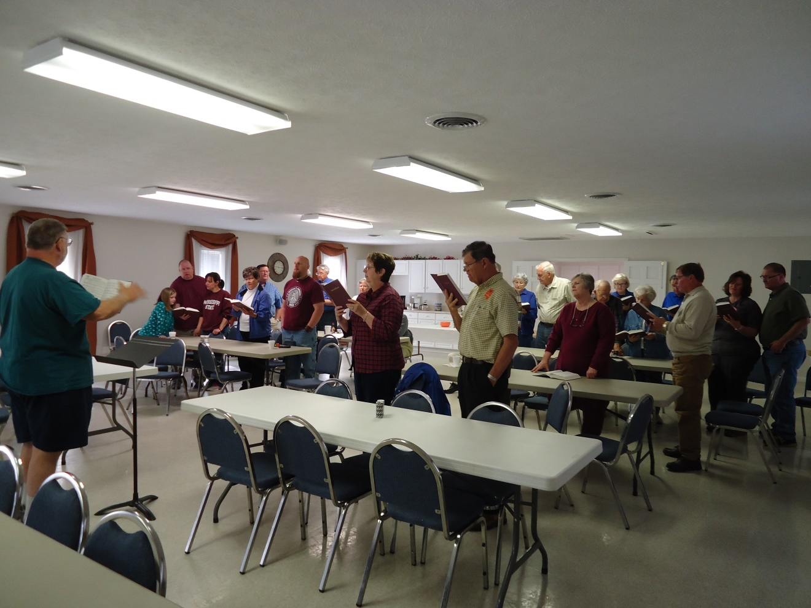

Slide 11
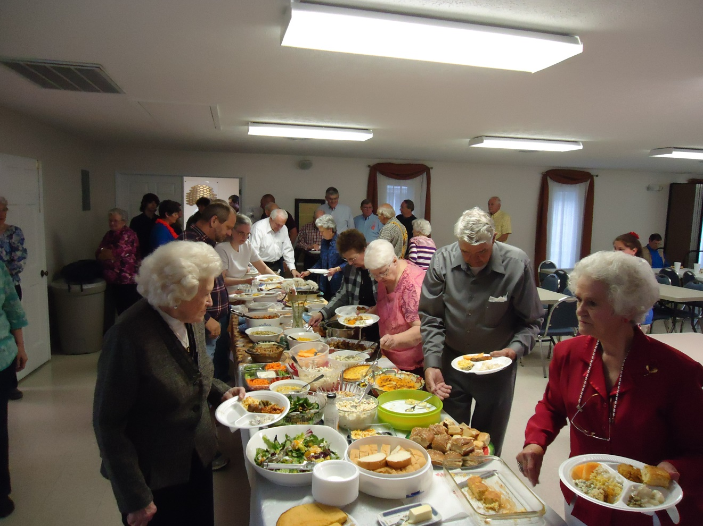

Slide 12
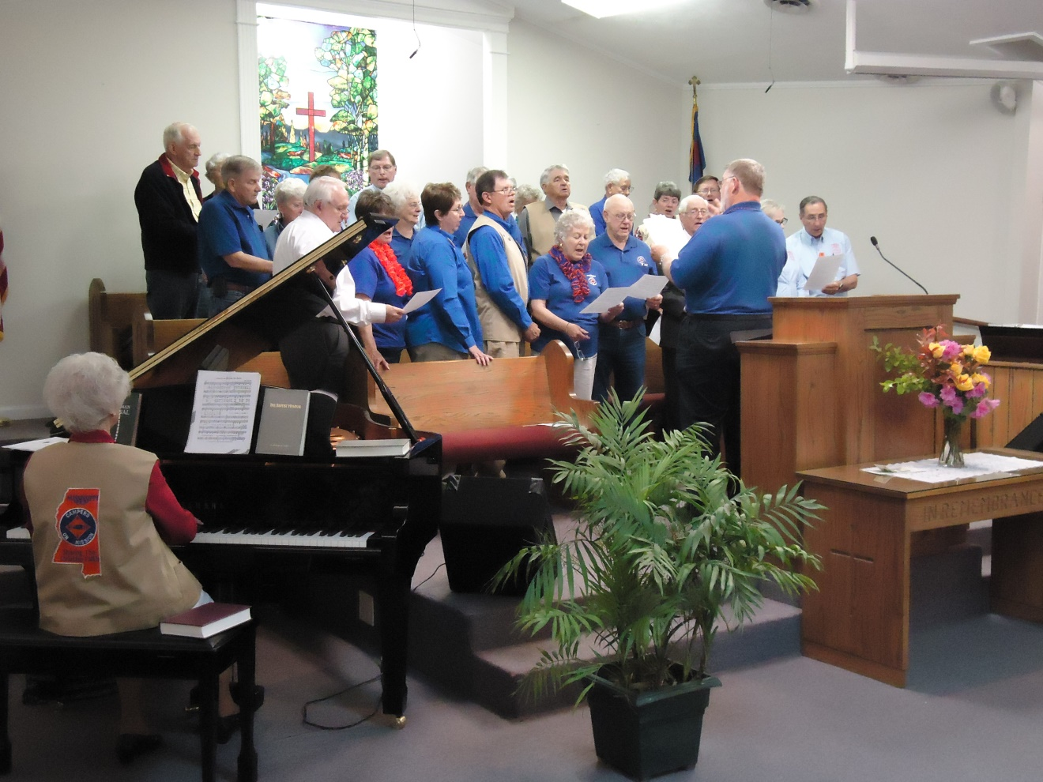

Slide 13
After Louisville, MS tornado
April 2014

Slide 14
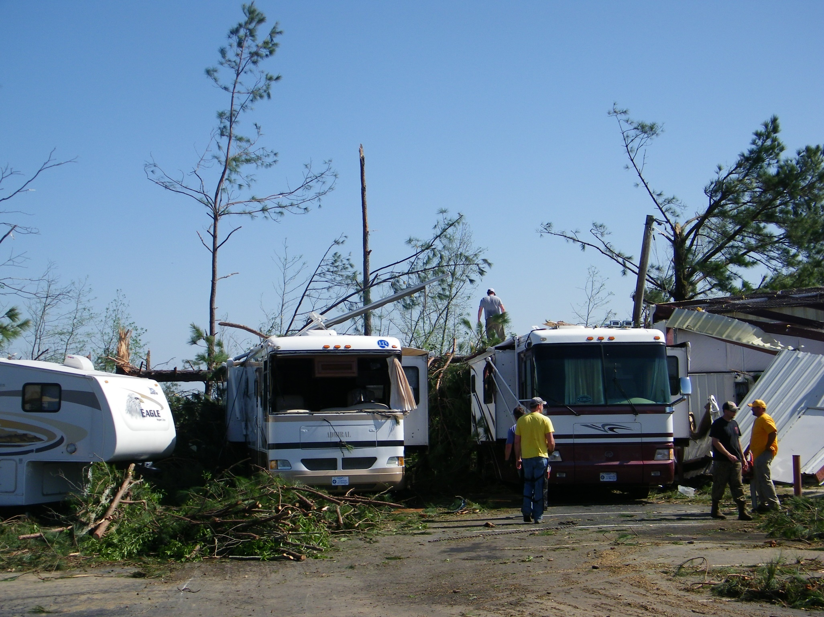

Slide 15
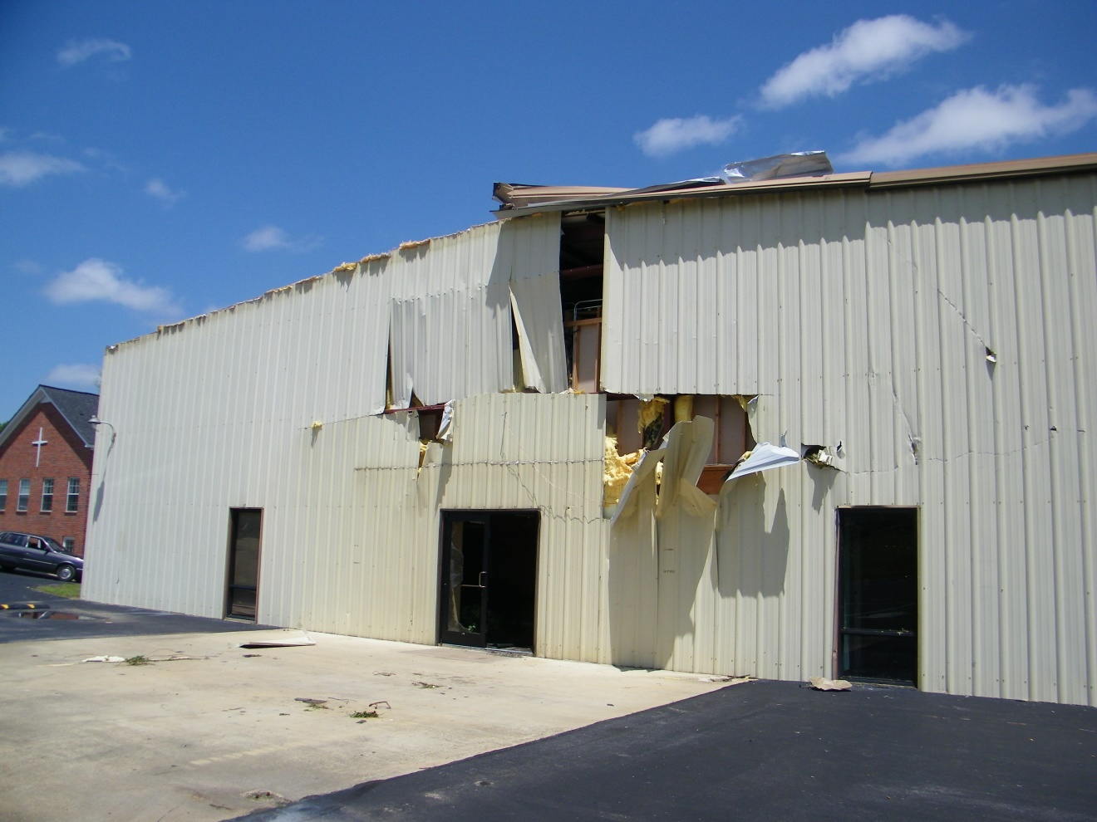

Slide 16
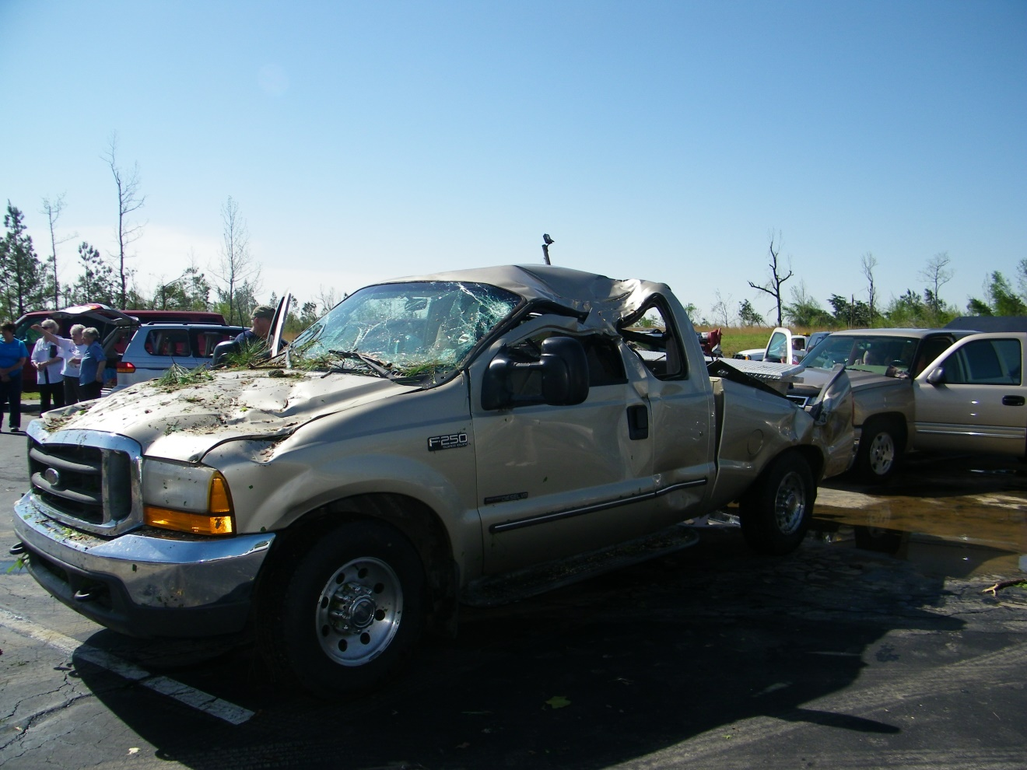

Slide 17
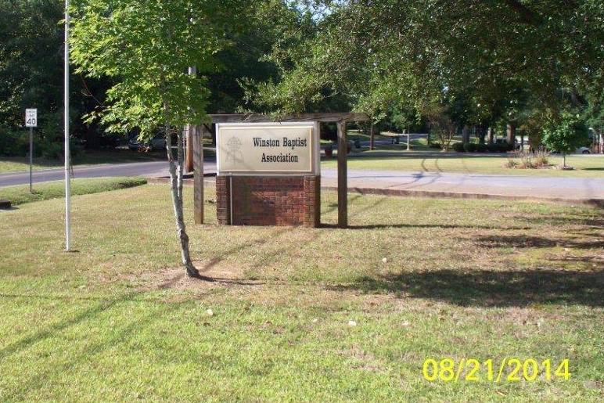
Winston Baptist Association
April and August 2014

Slide 18
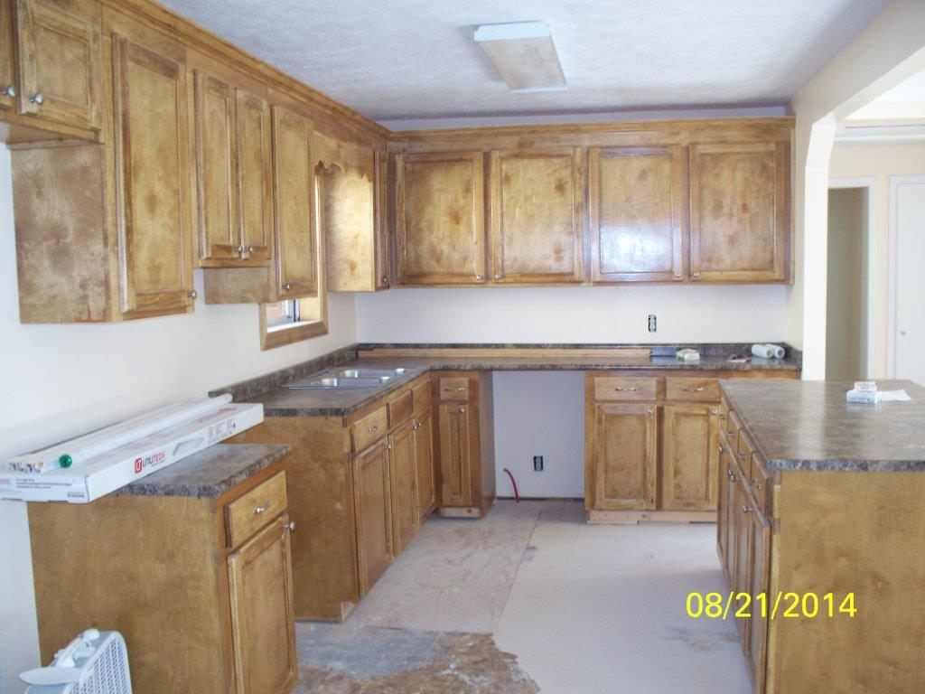

Slide 19
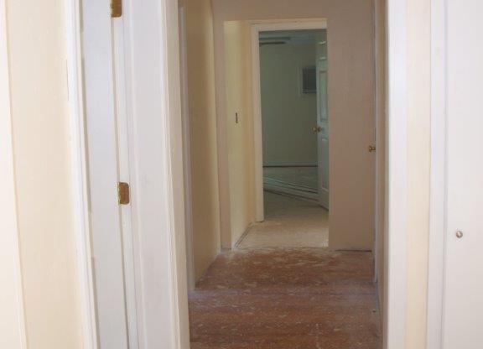

Slide 20
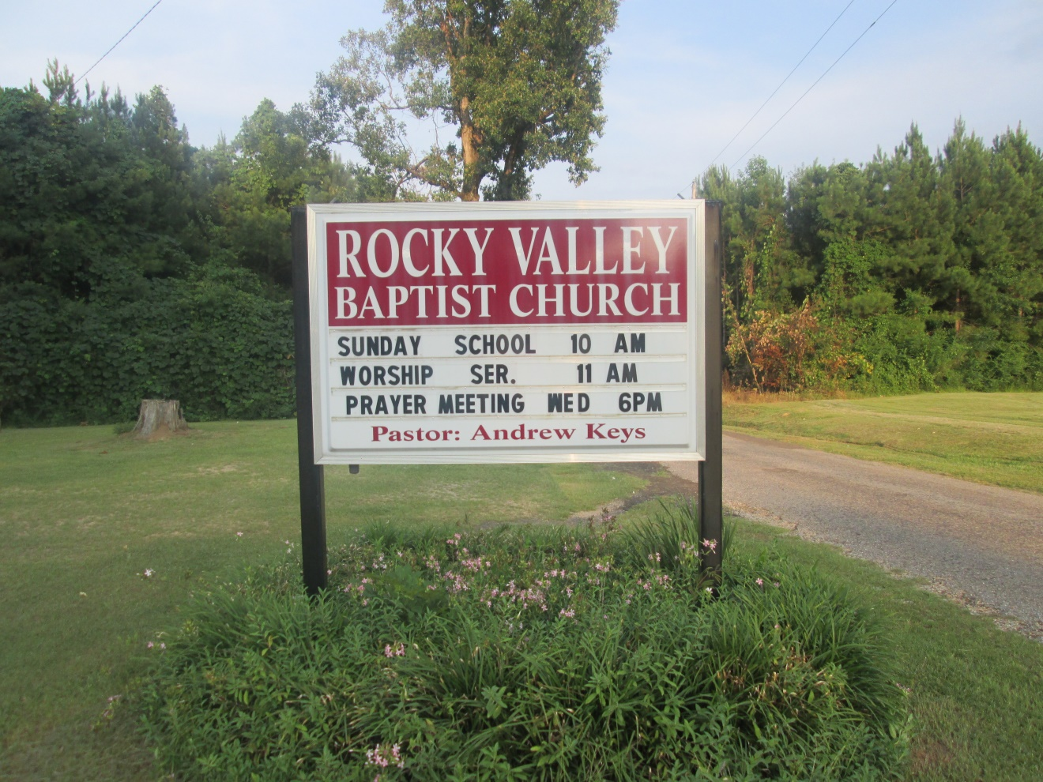
Rocky Valley Baptist Church, Collins, ms
November, 2014

Slide 21
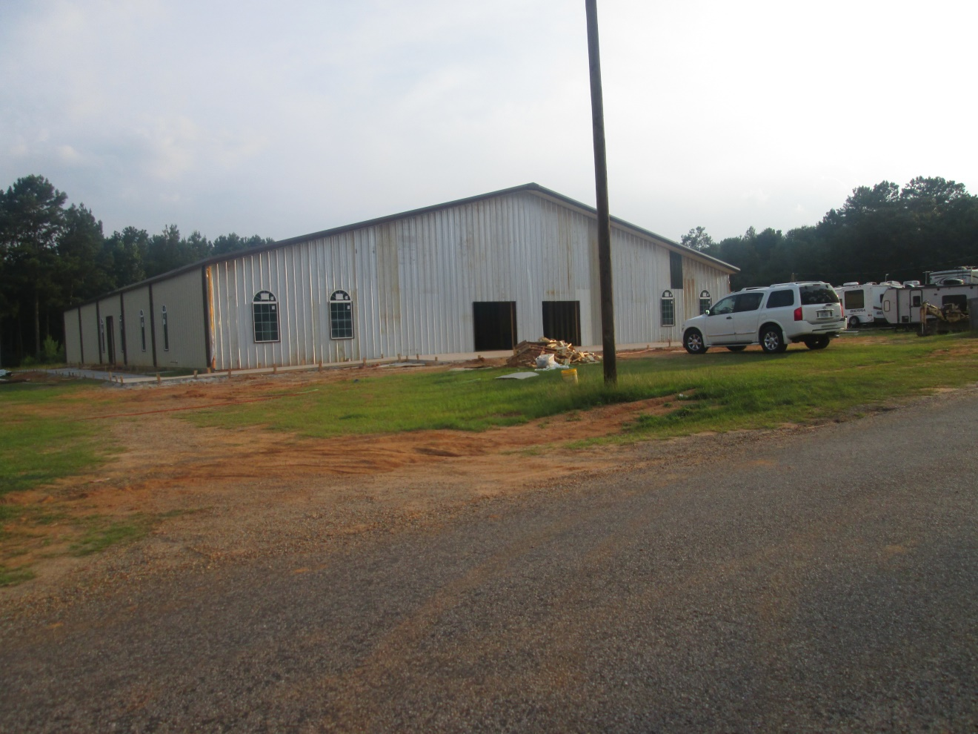

Slide 22
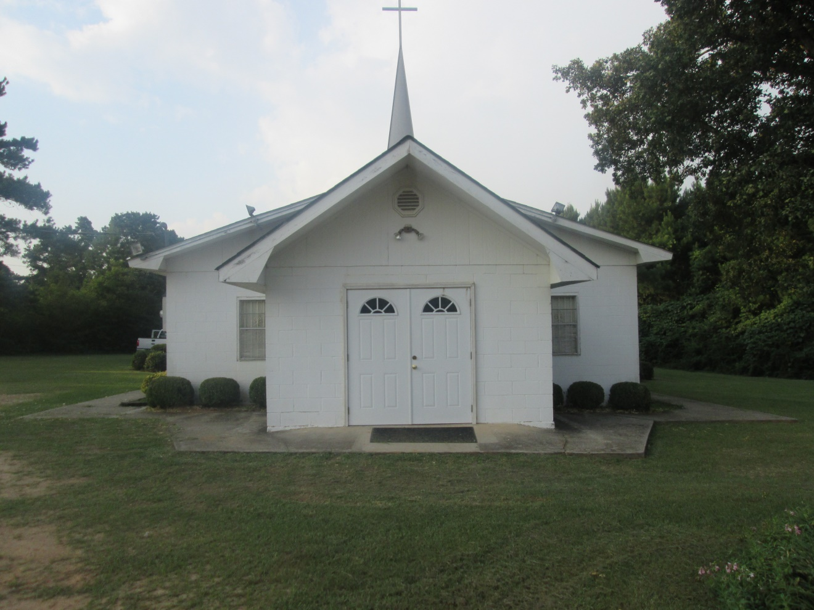

Slide 23
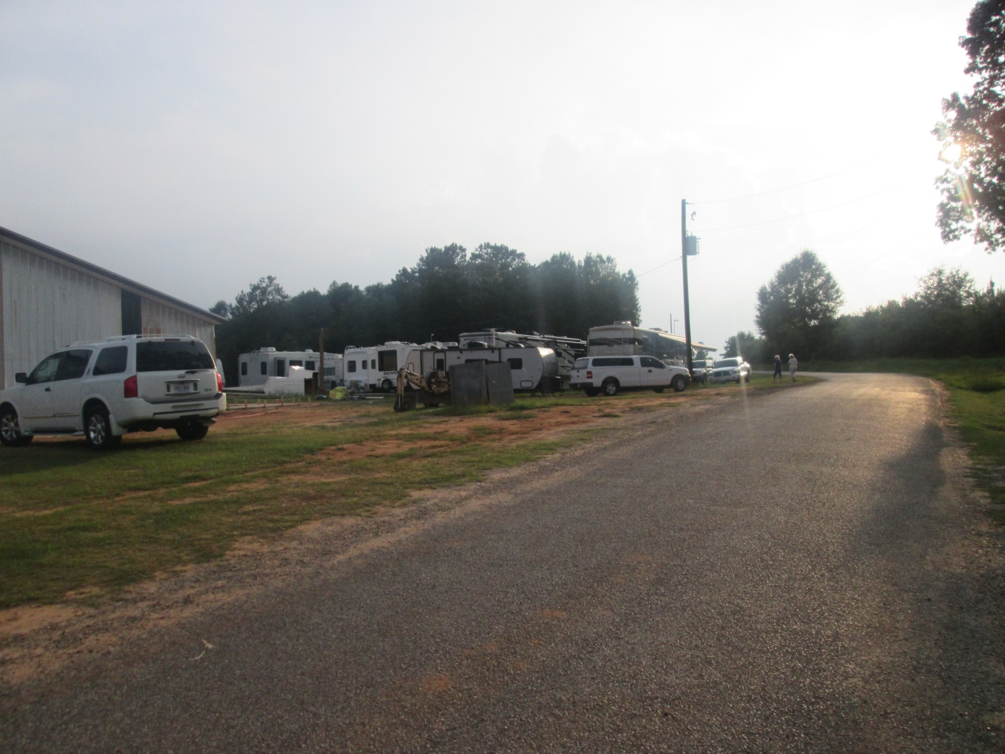

Slide 24
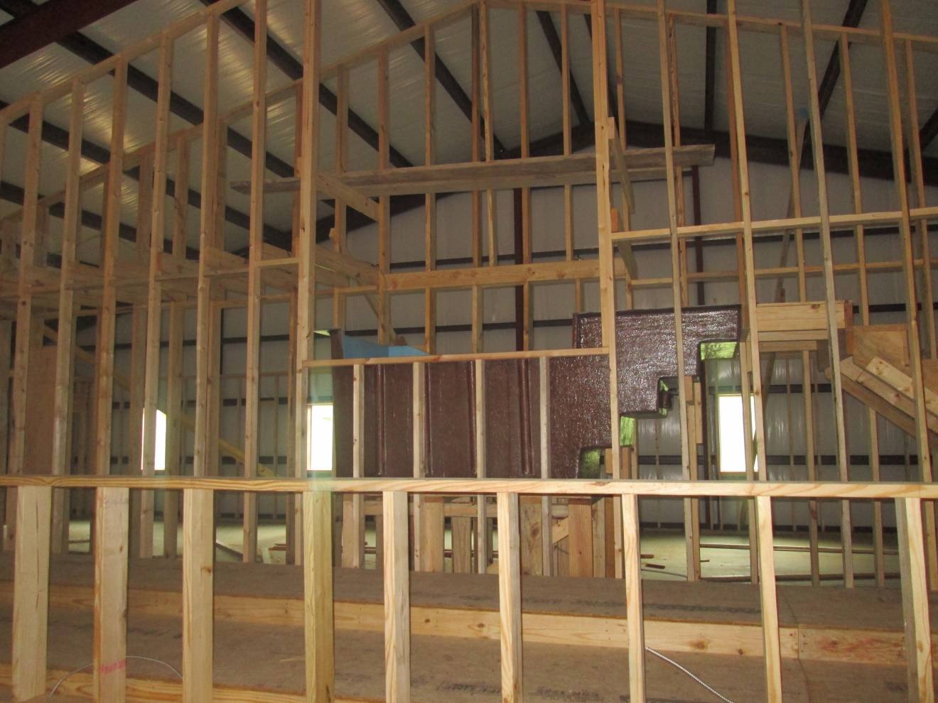

Slide 25
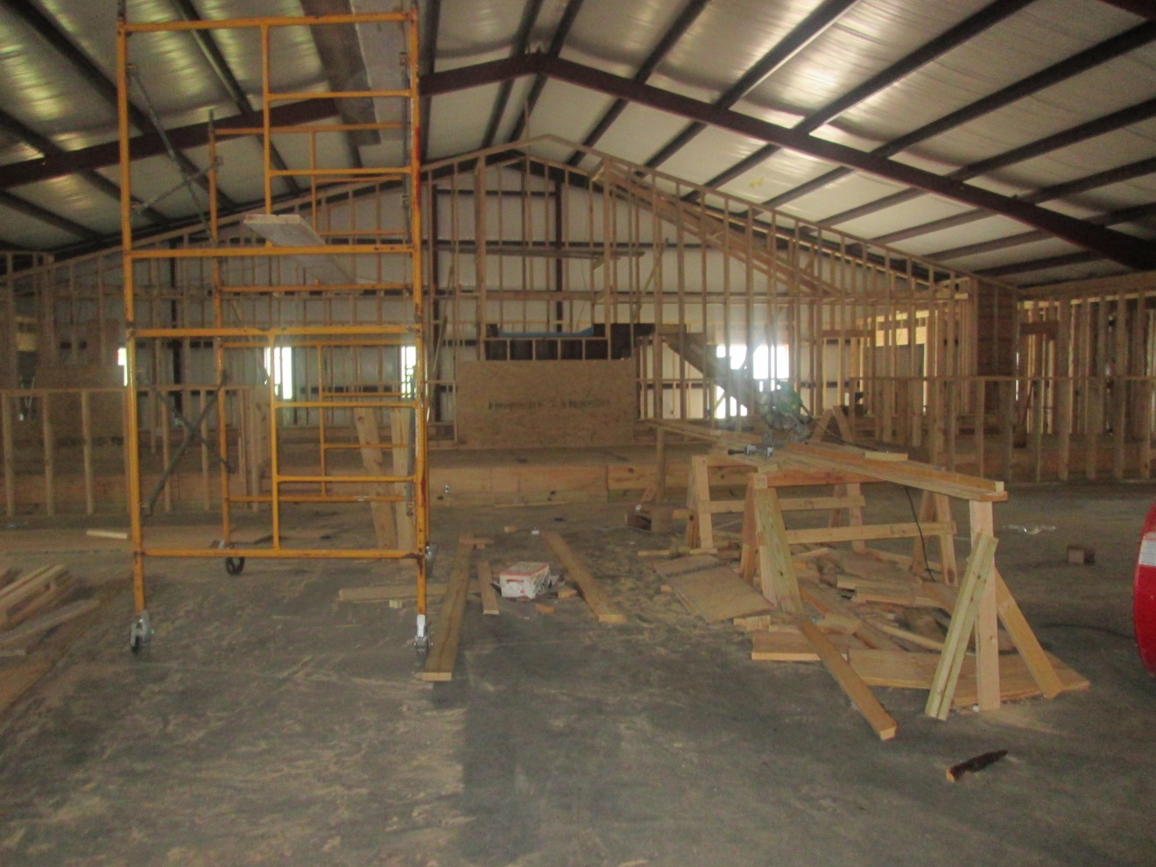

Slide 26
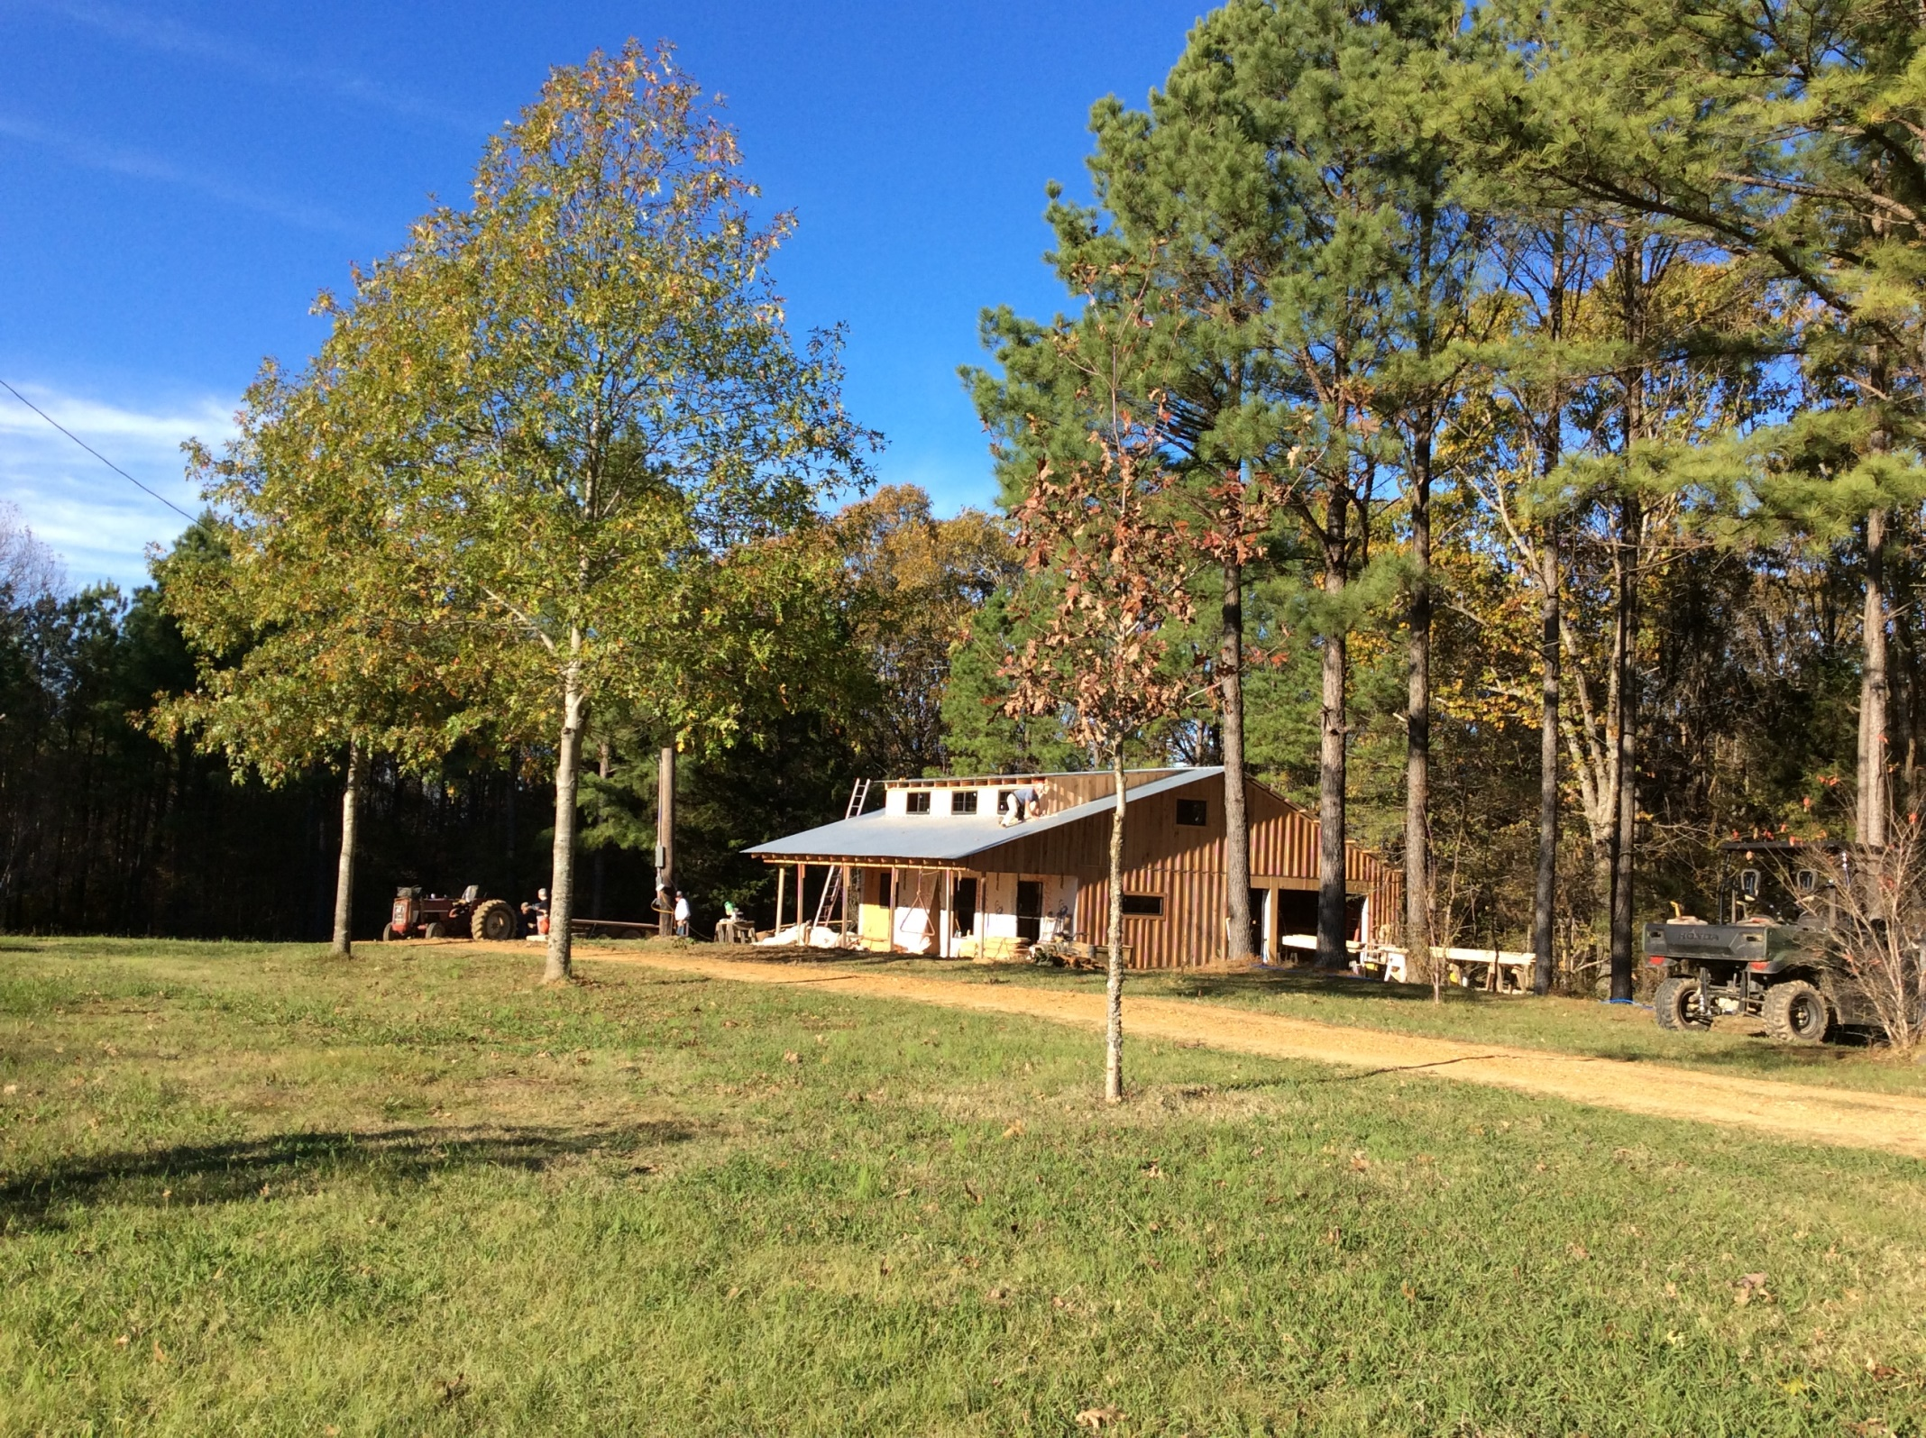
Batesville Handicapped
Cabin Project
May 2015

Slide 27
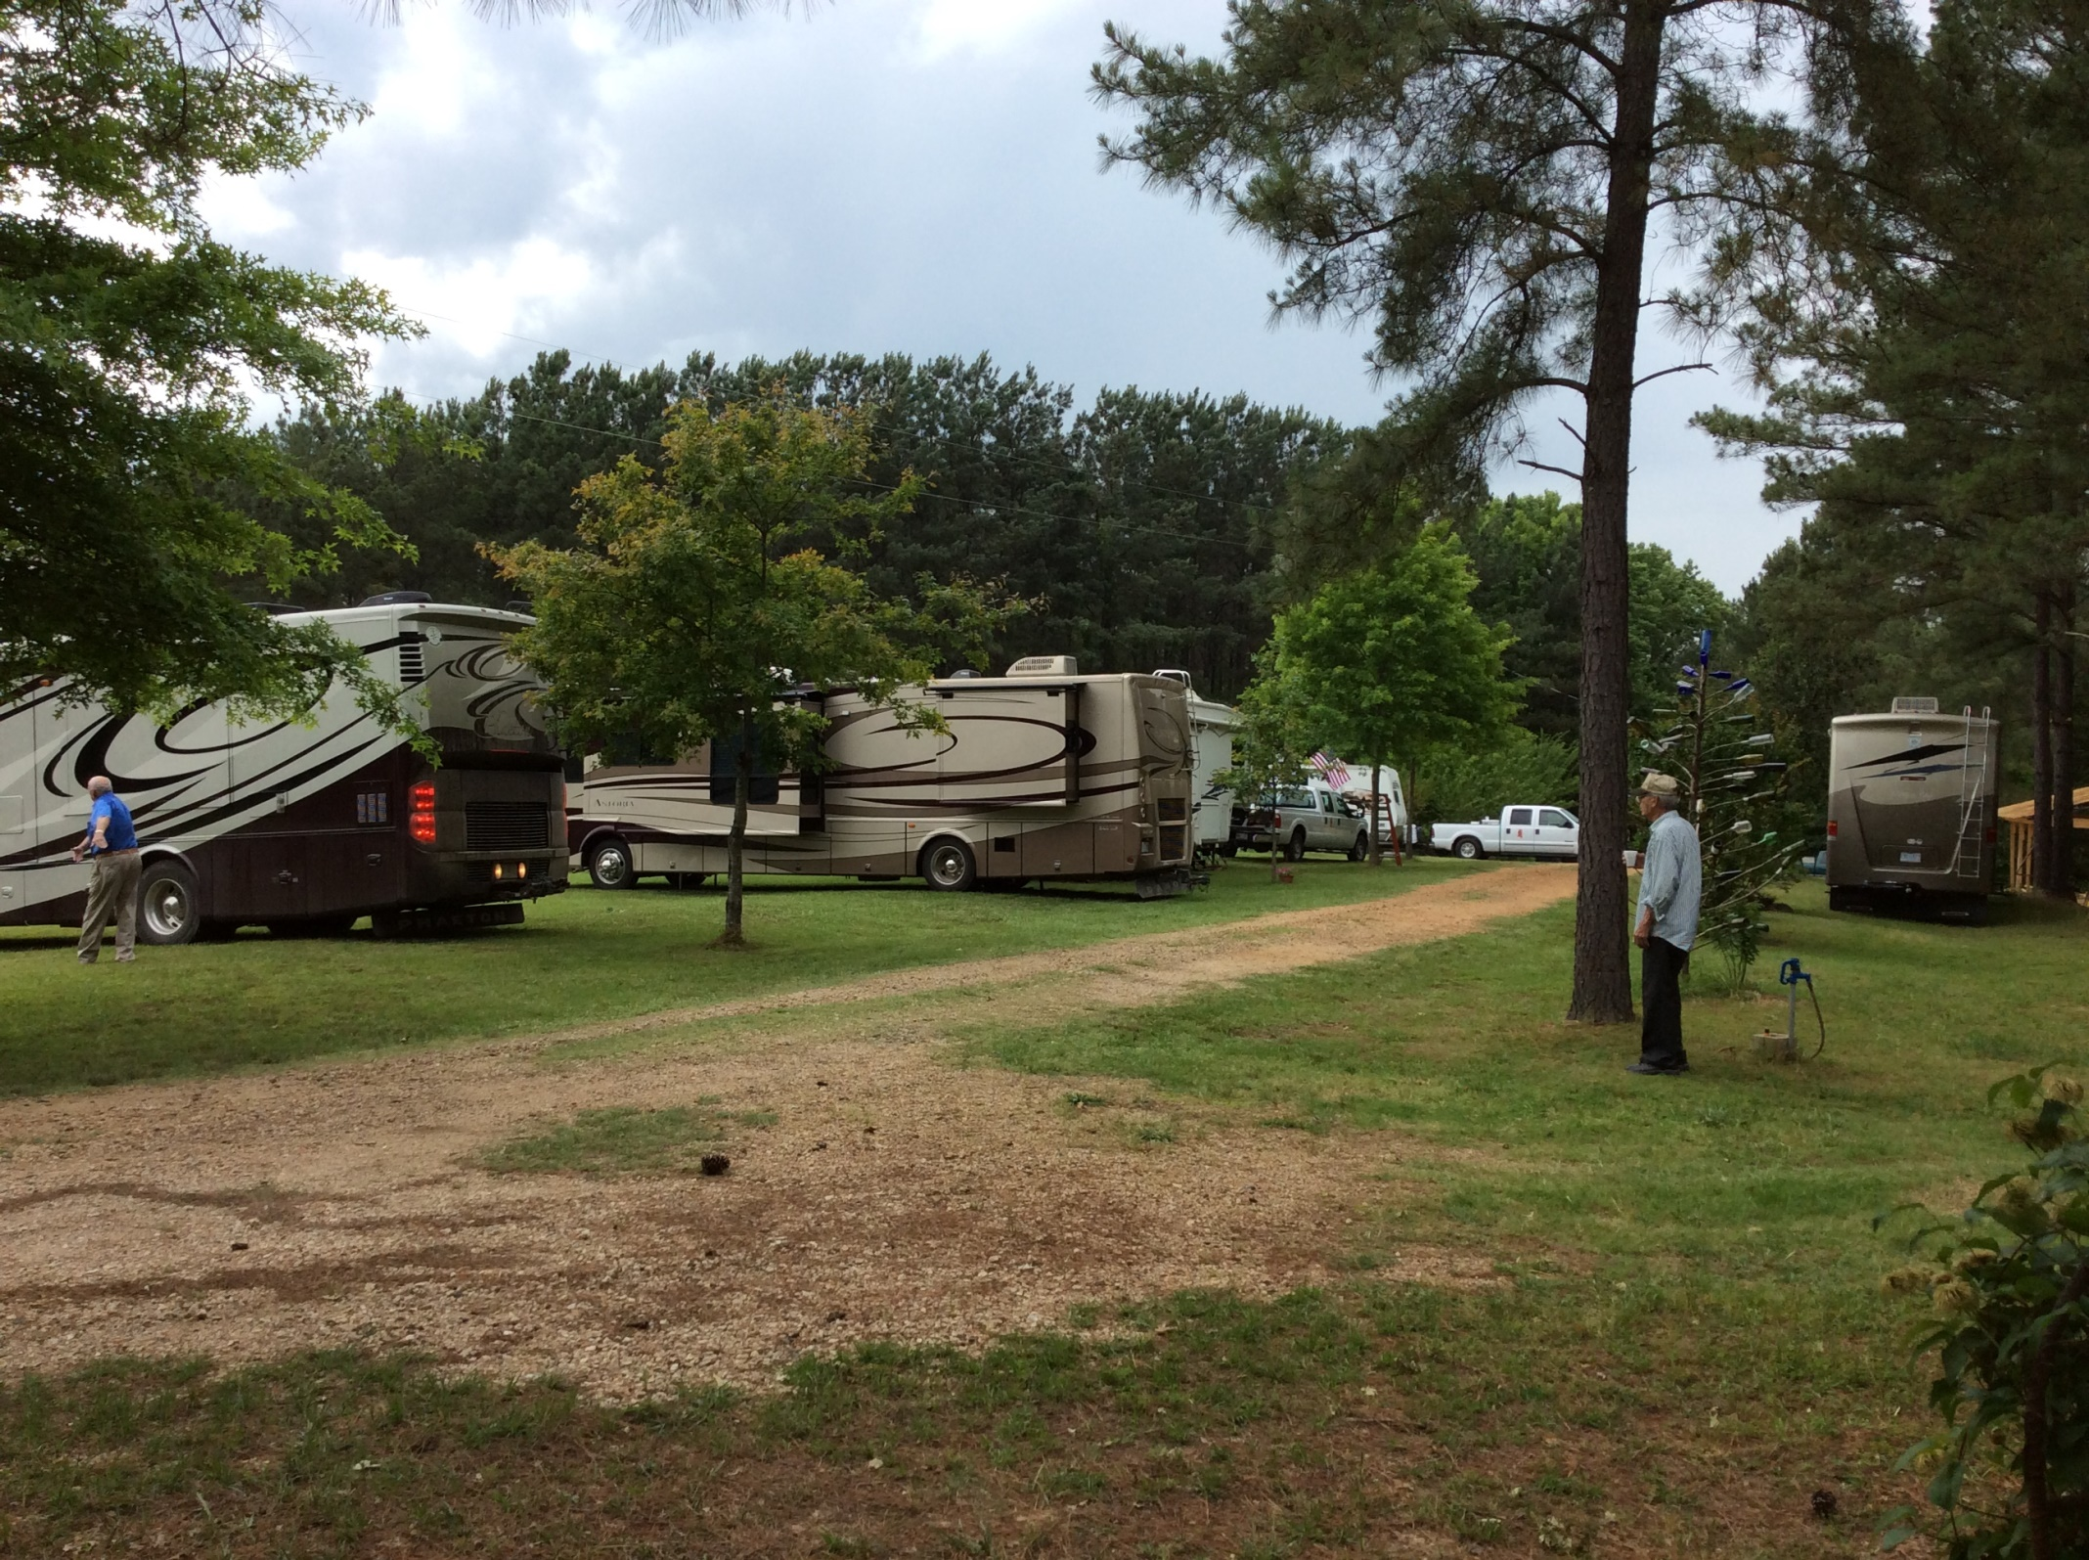

Slide 28
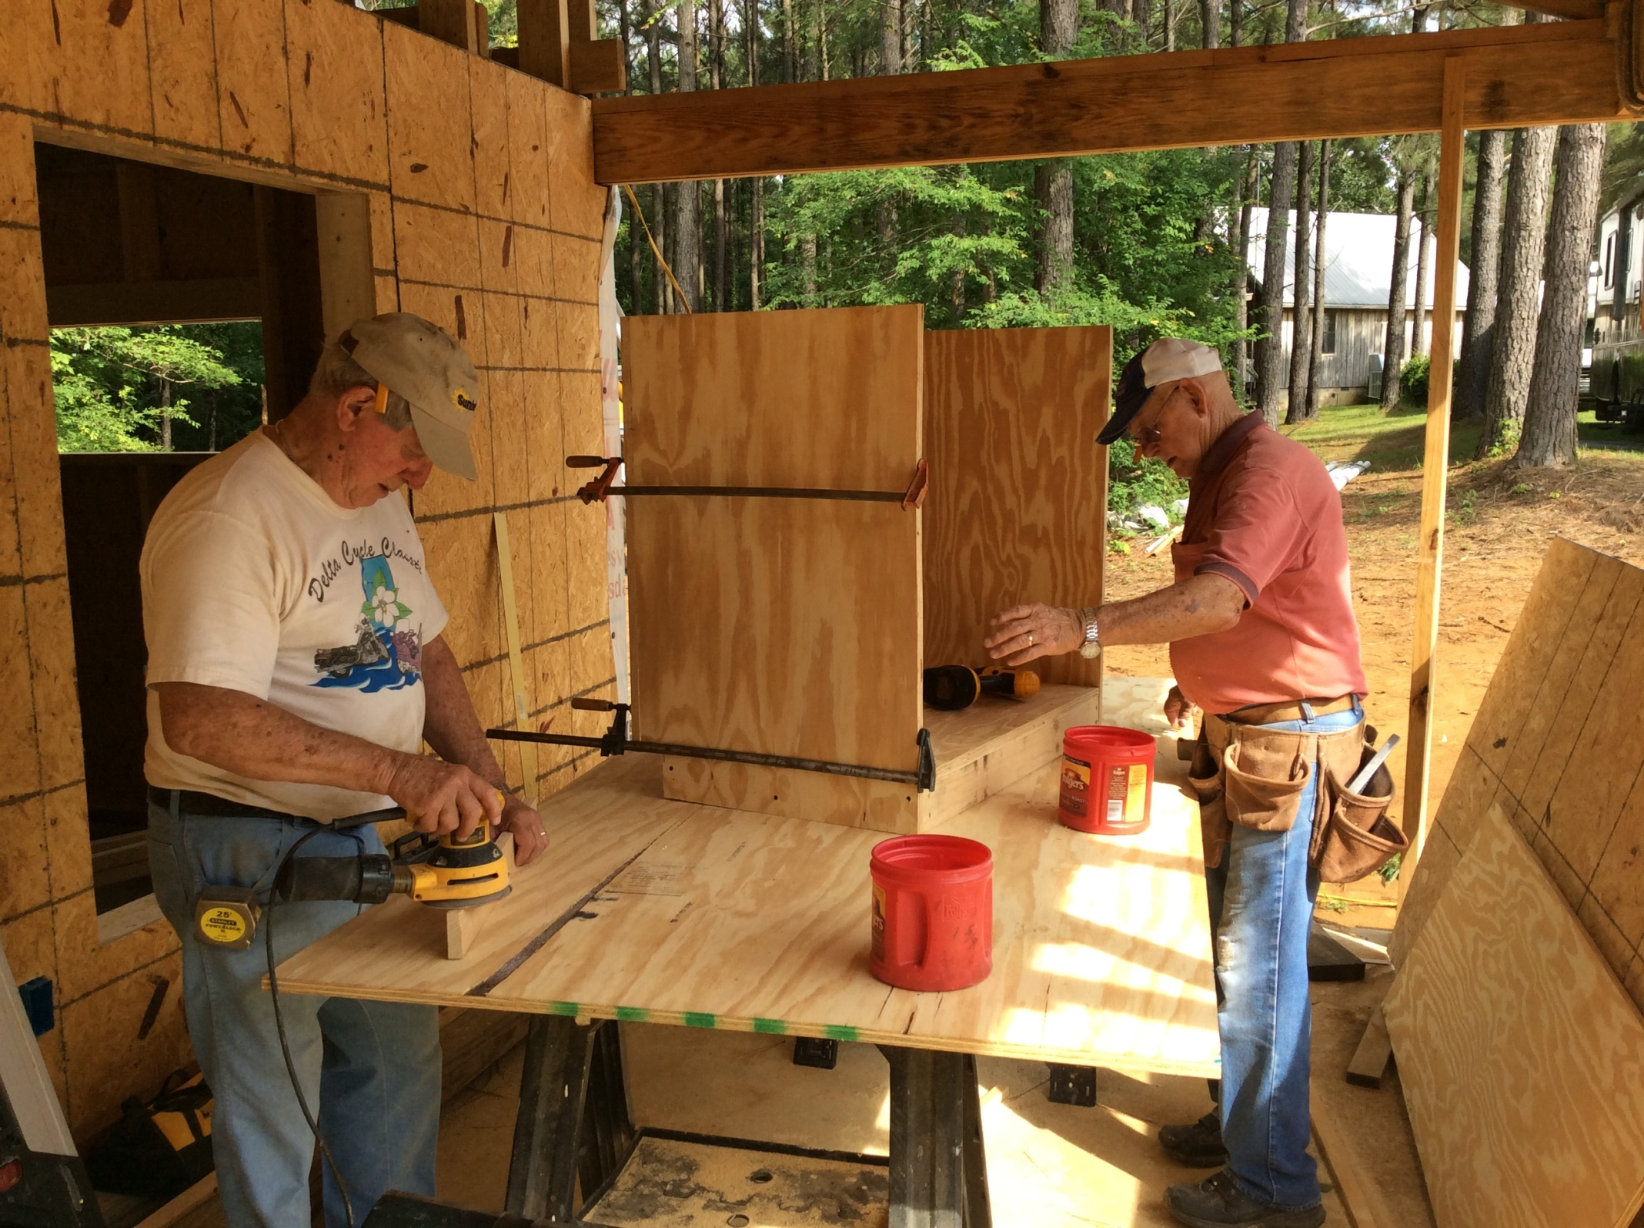

Slide 29
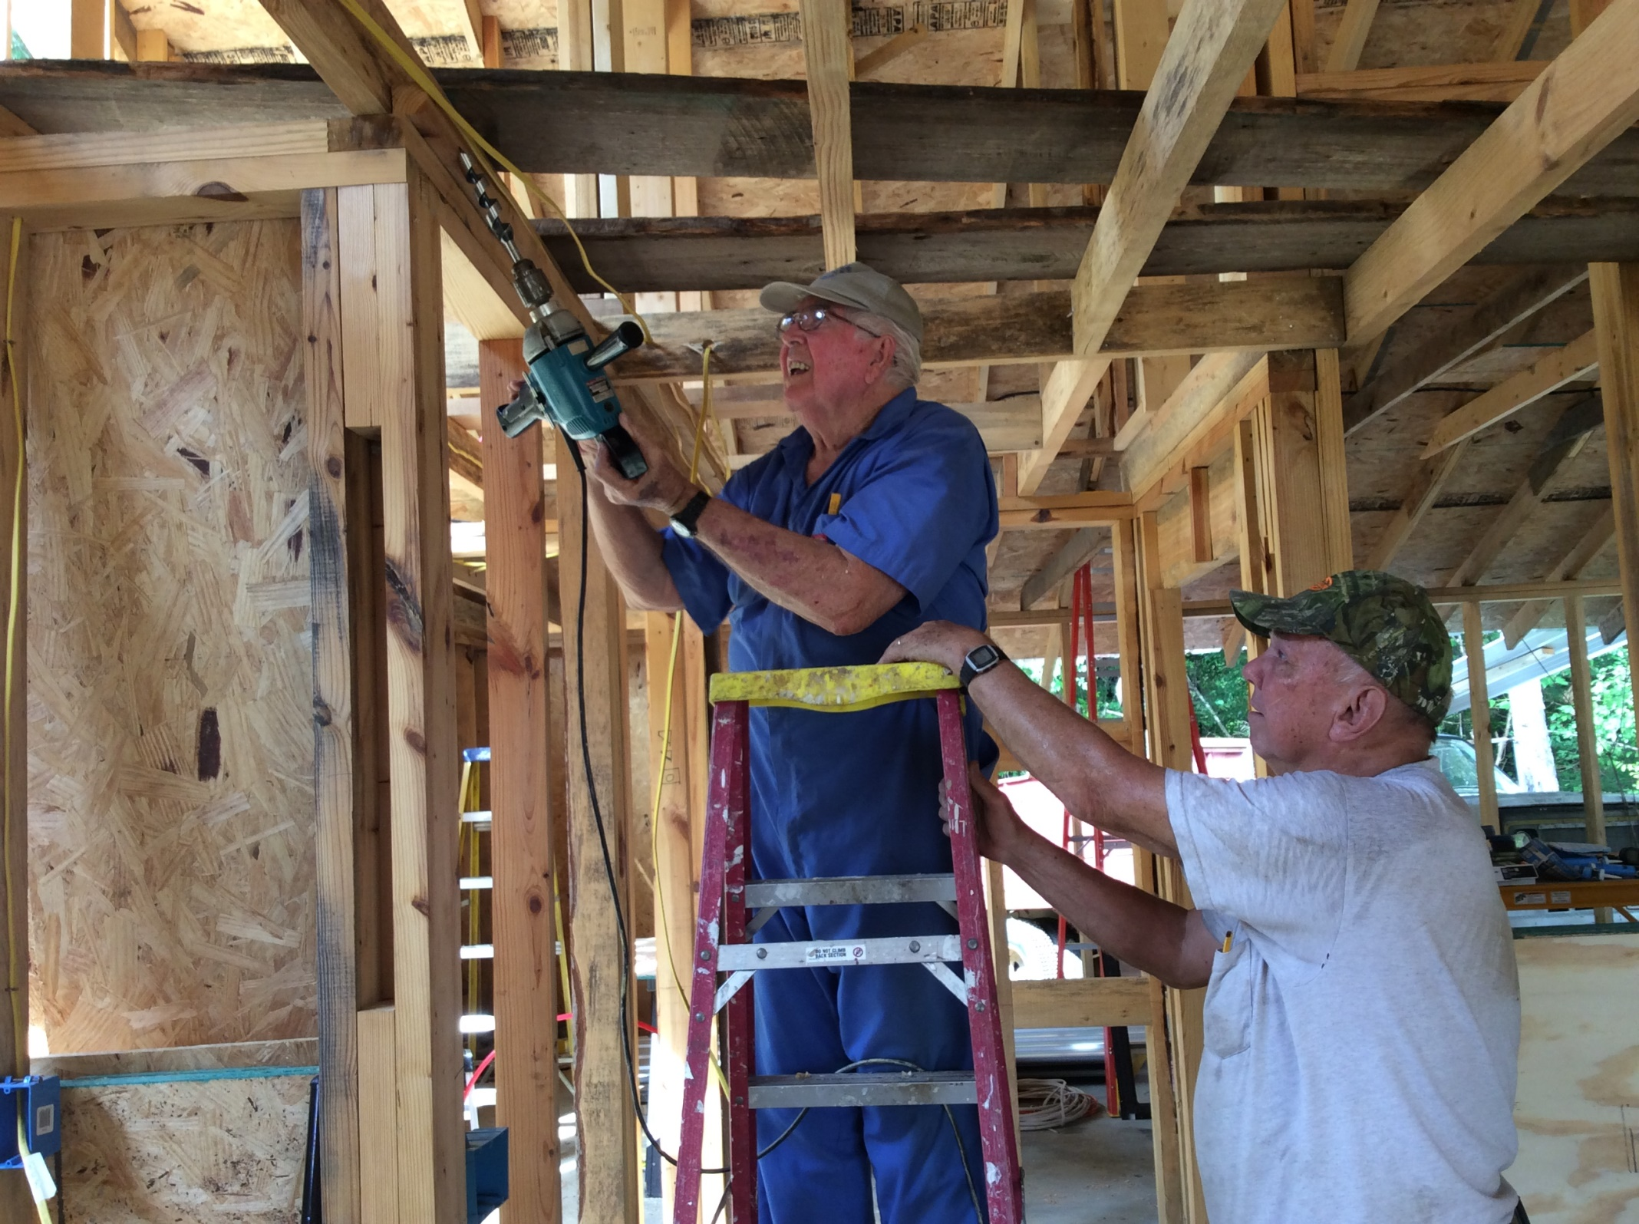

Slide 30
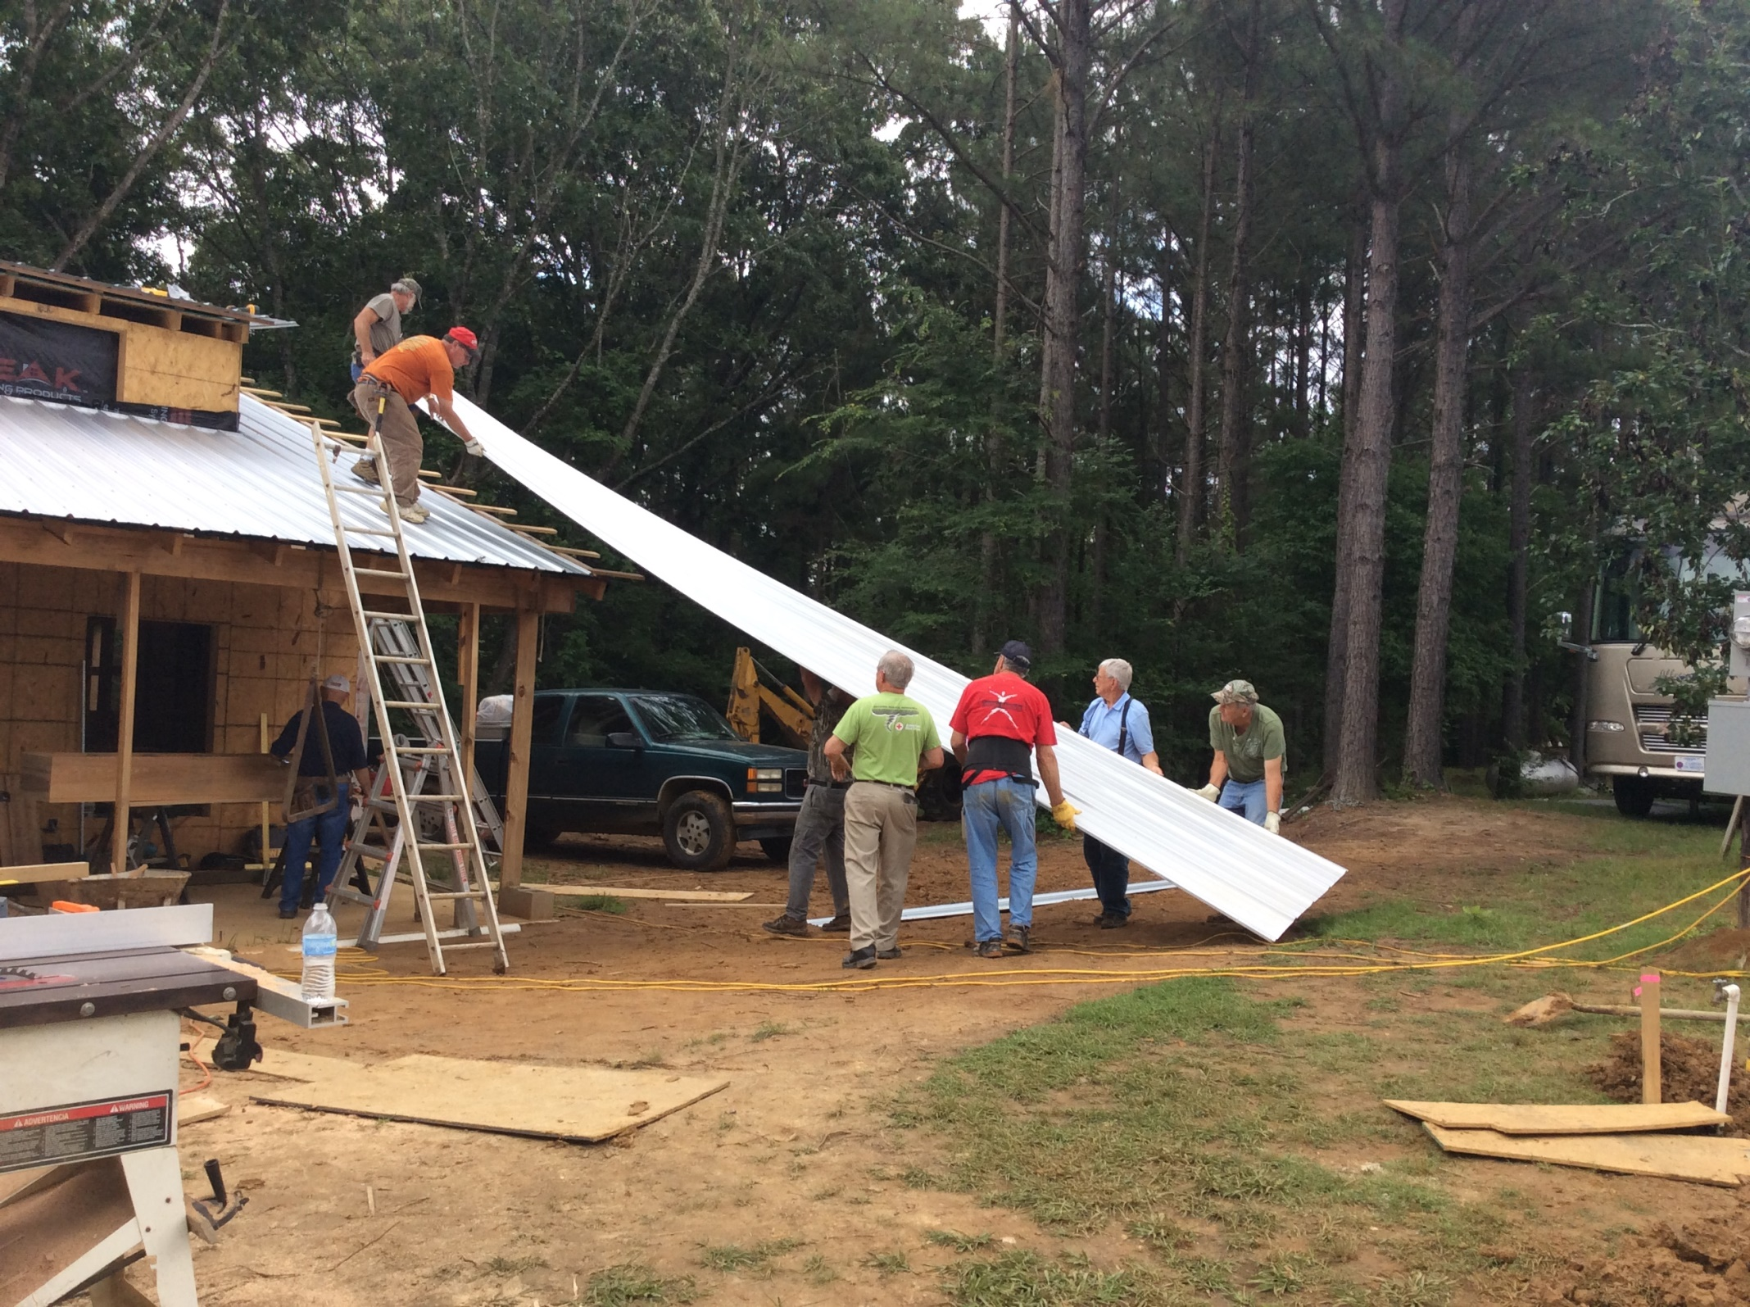

Slide 31
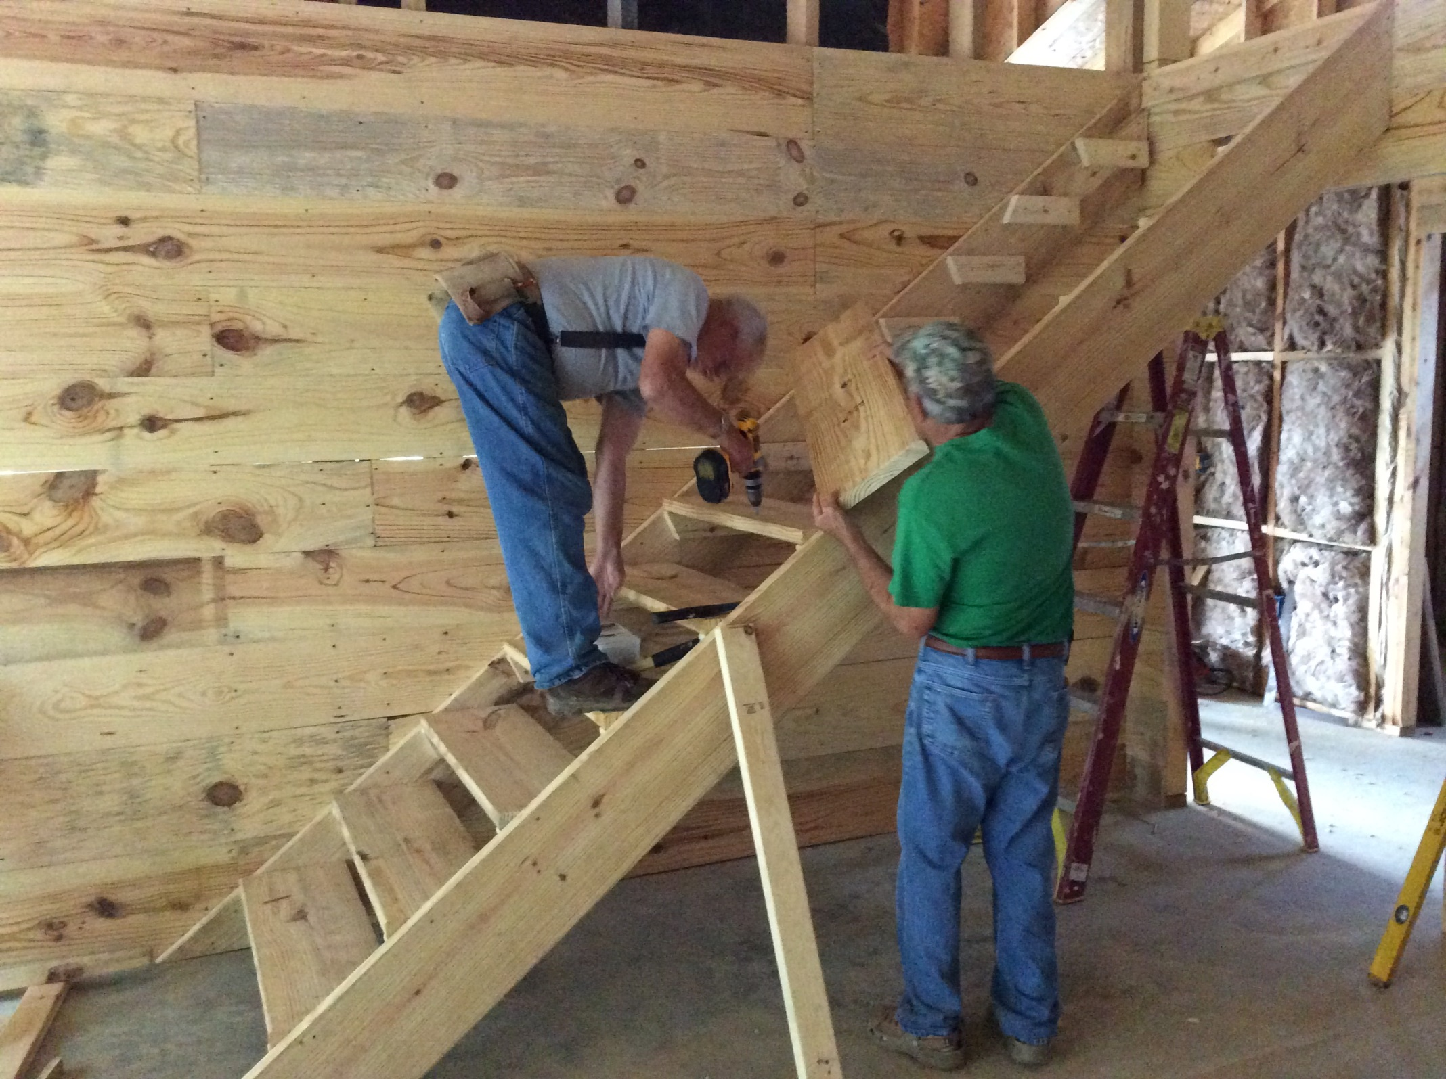

Slide 32
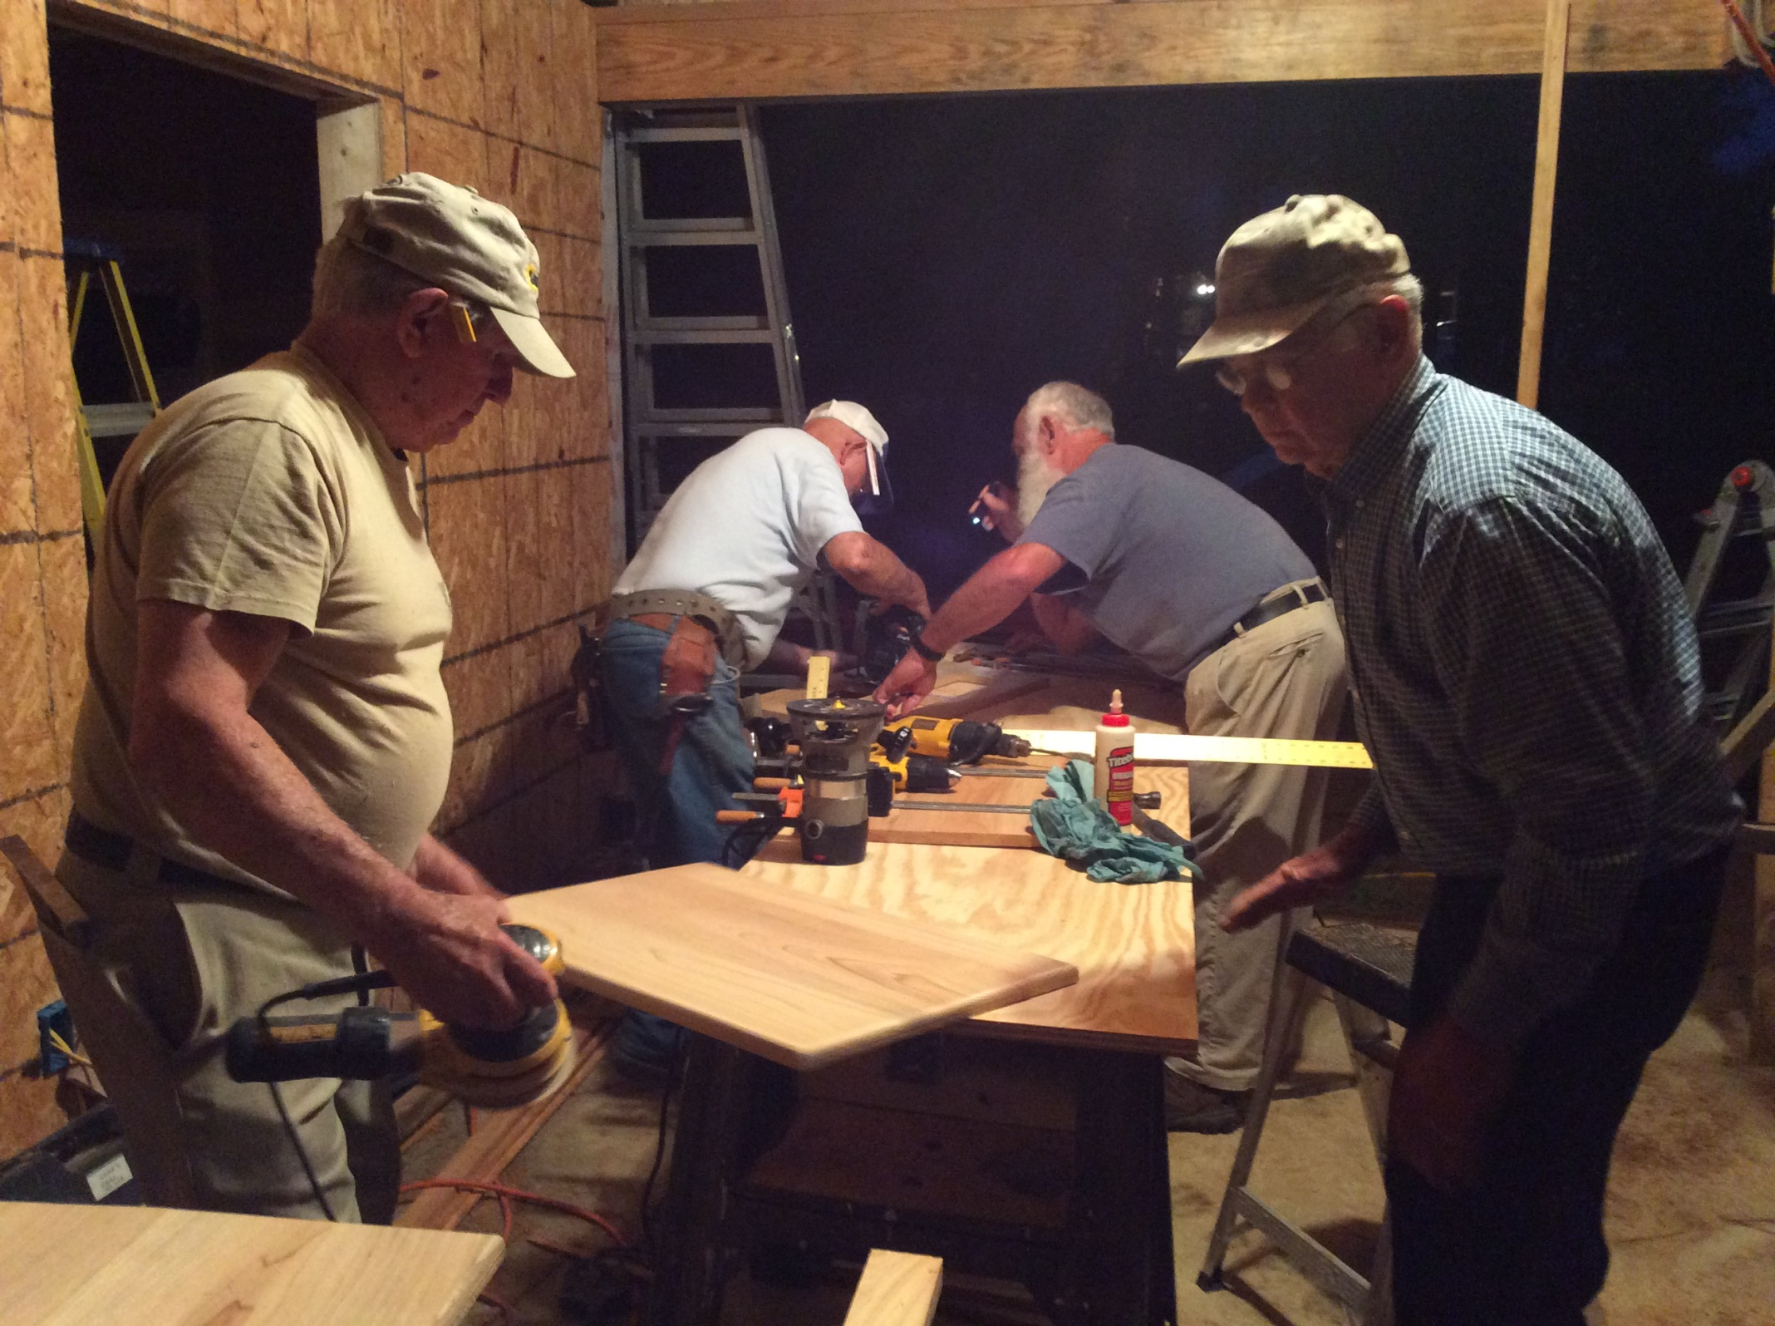

Slide 33
First Baptist Church, belzoni, ms
Revival
July 2015

Slide 34
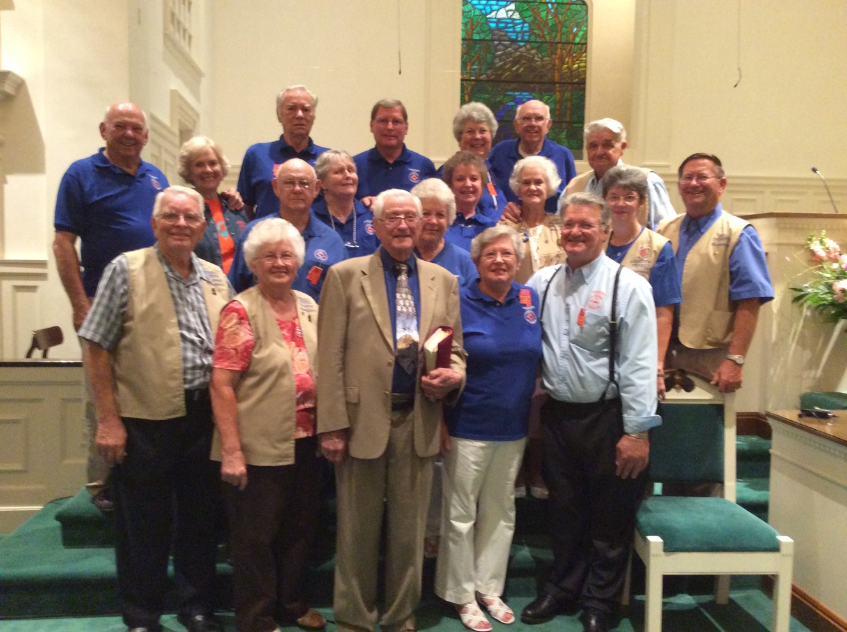

Slide 35
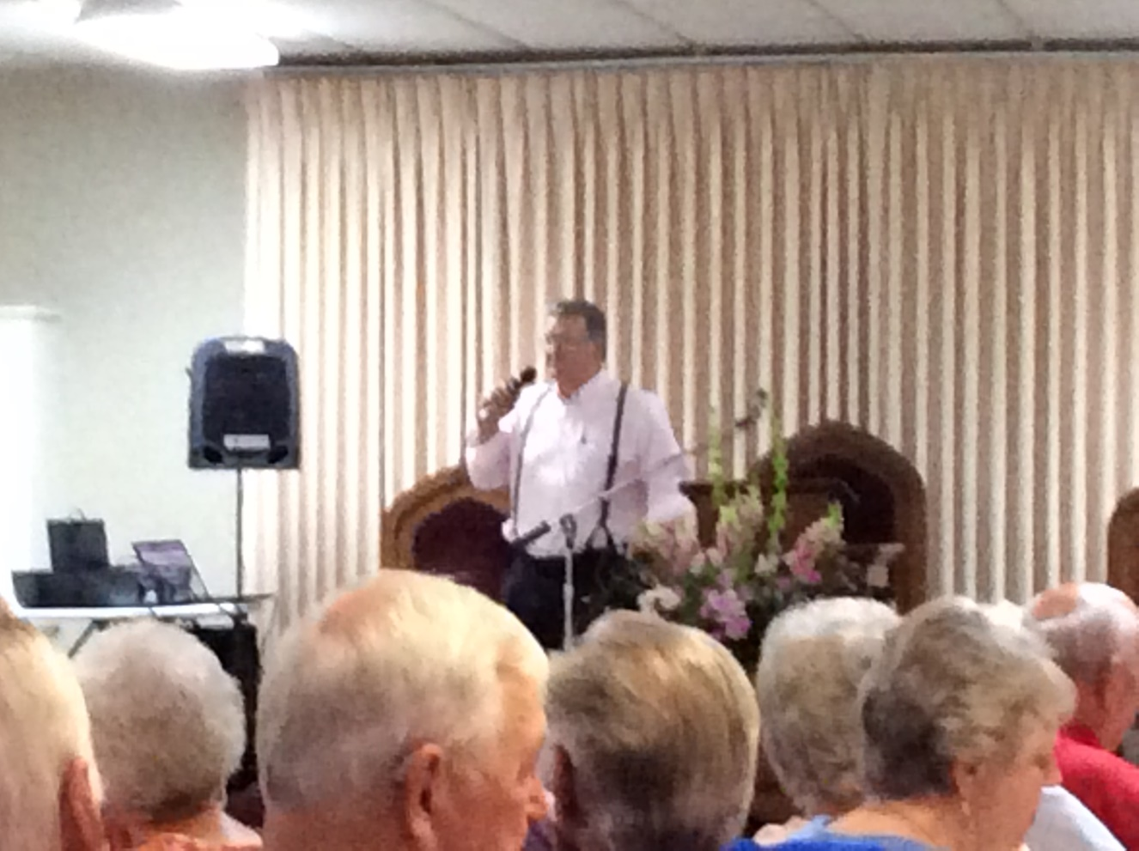

Slide 36
North Carrollton Baptist Church,
North Carrollton, MS
Revival week And work project
At Parsonage
October, 2015

Slide 37
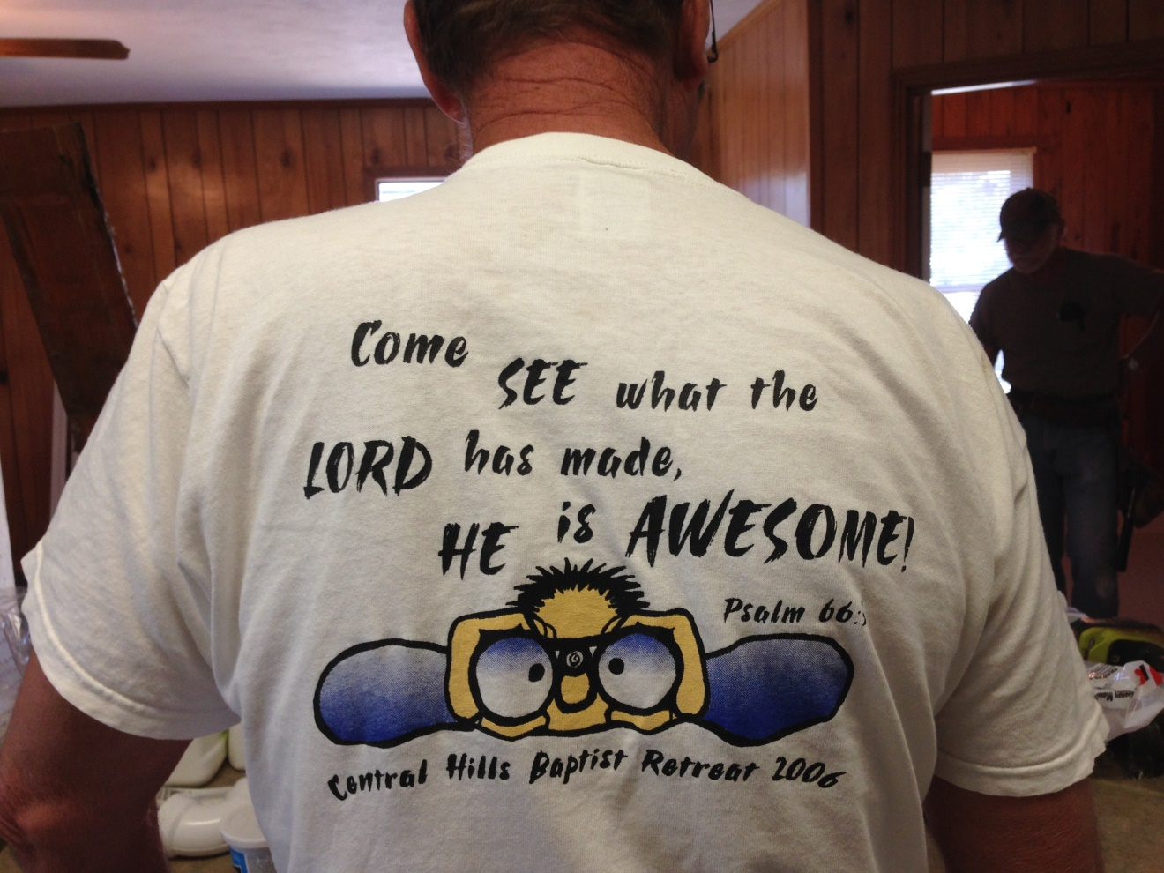

Slide 38
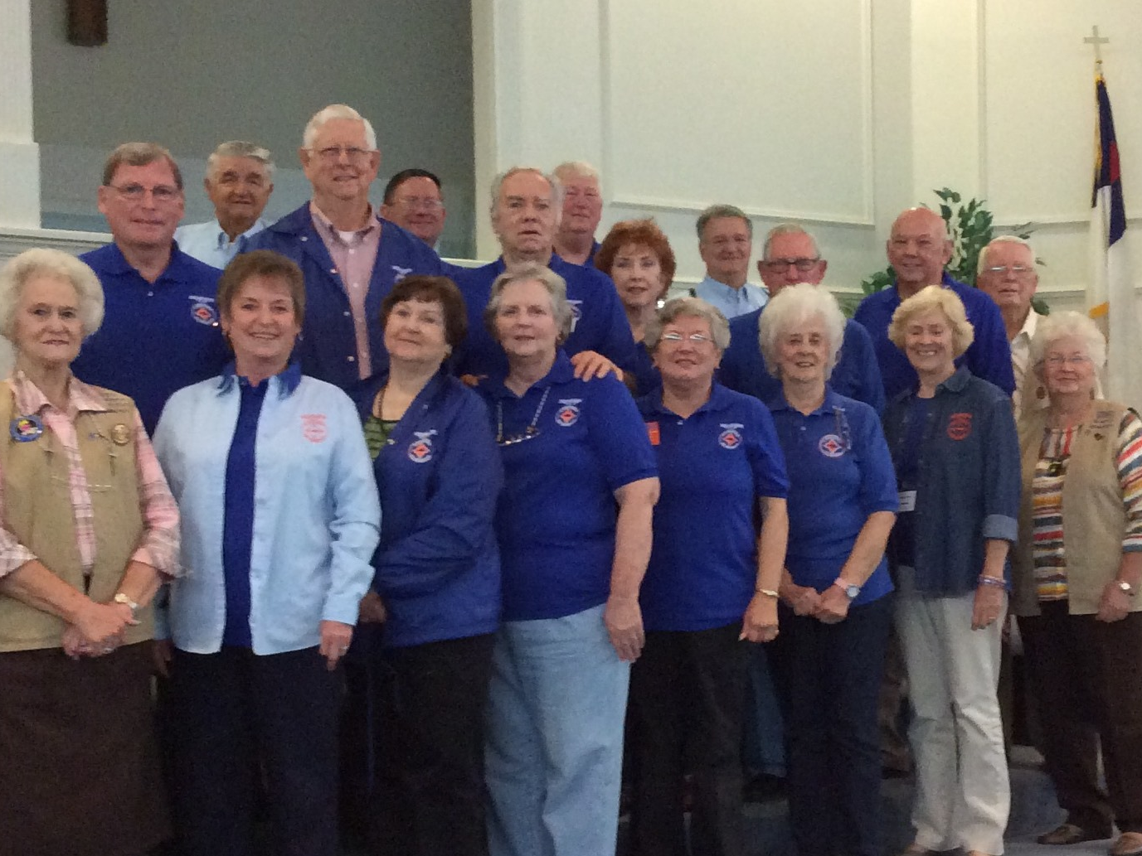

Slide 39
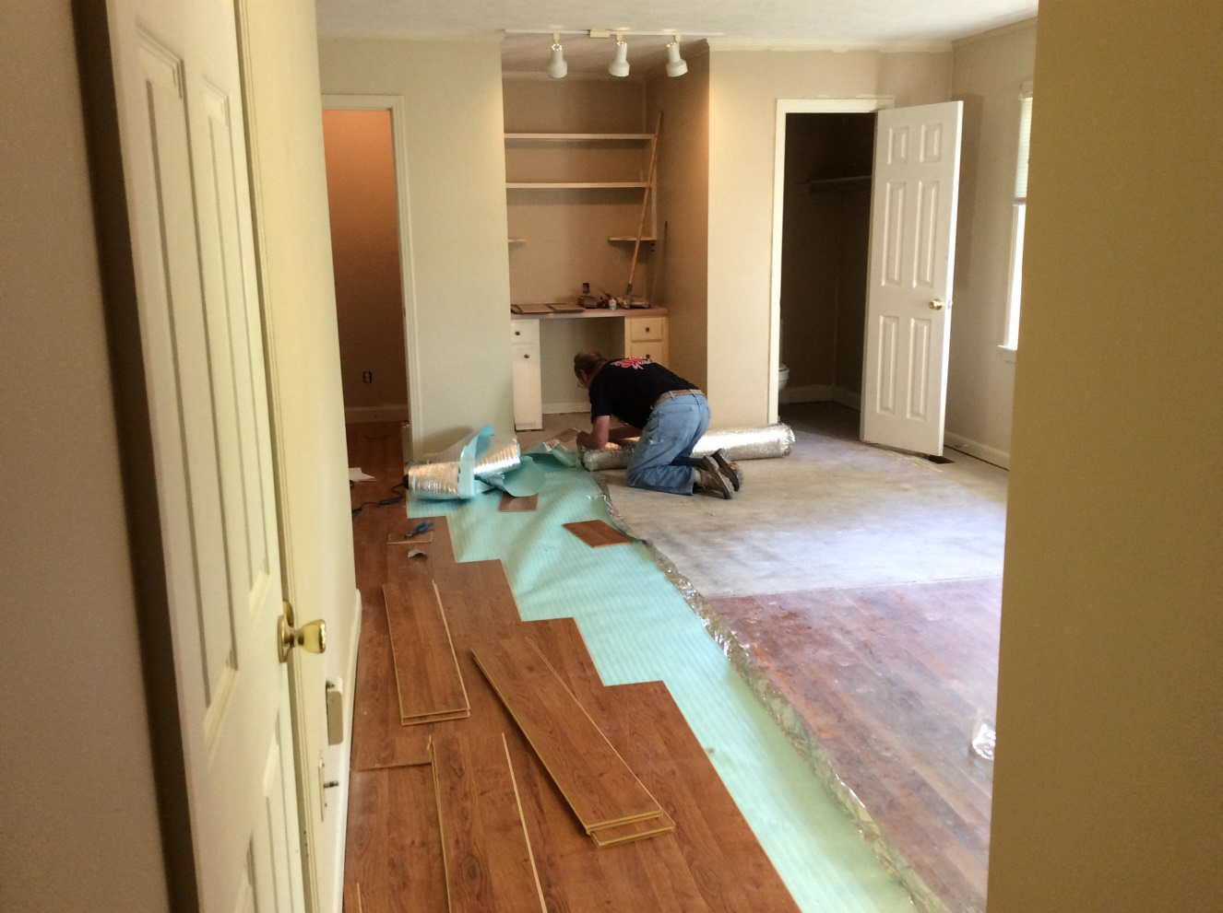

Slide 40
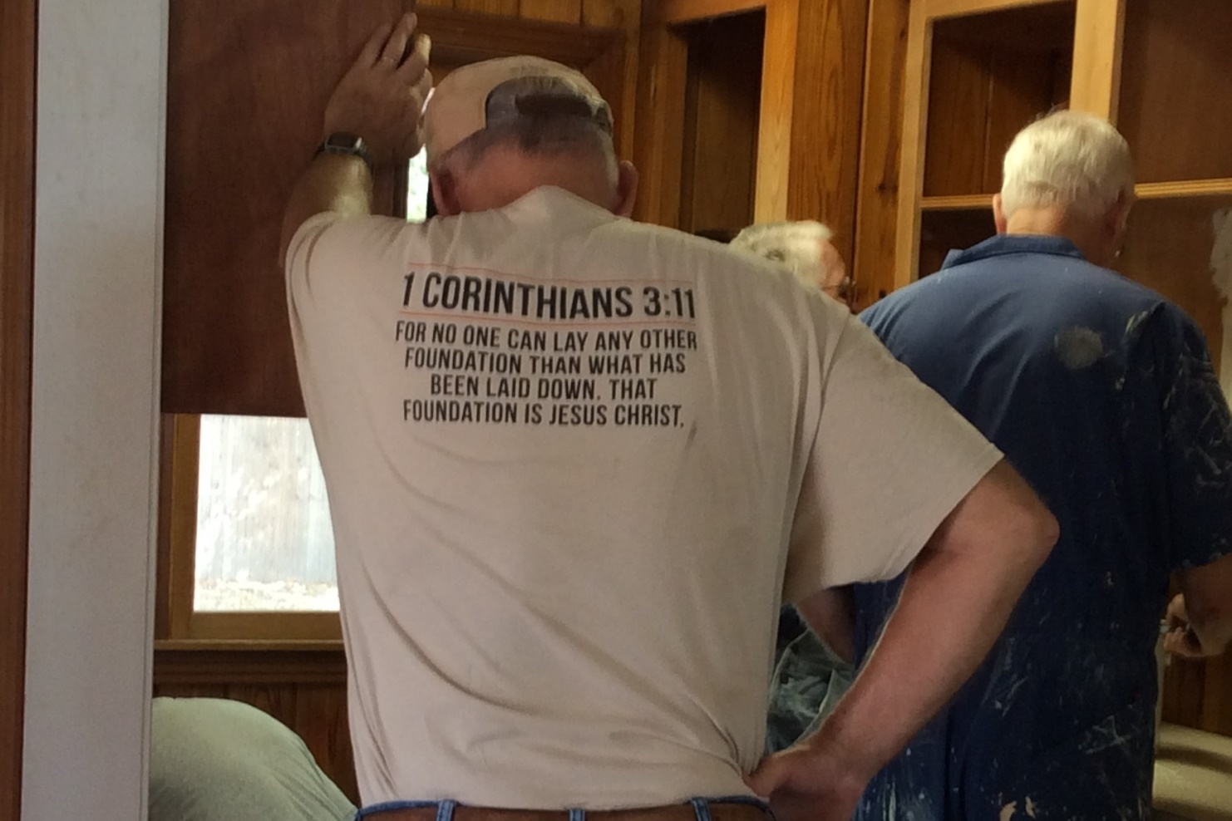

Slide 41
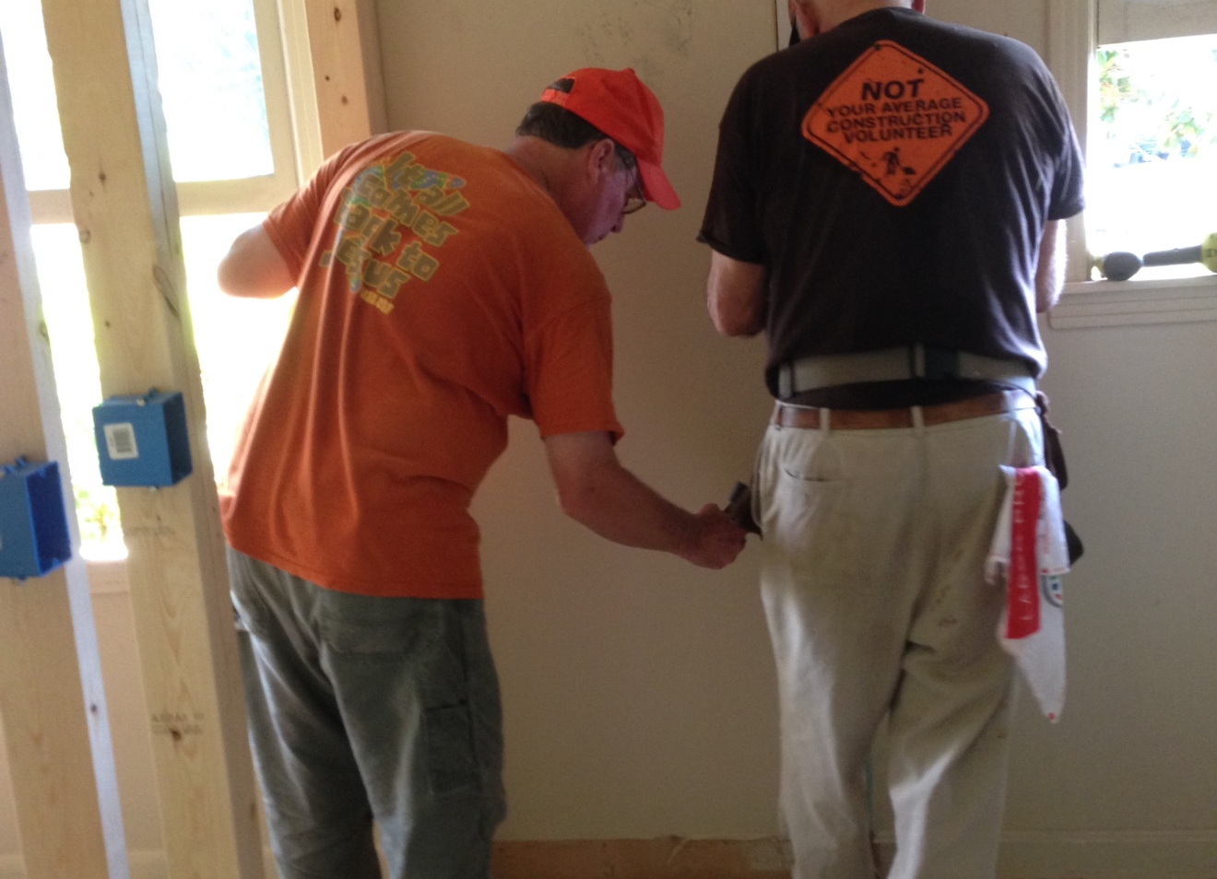

Slide 42
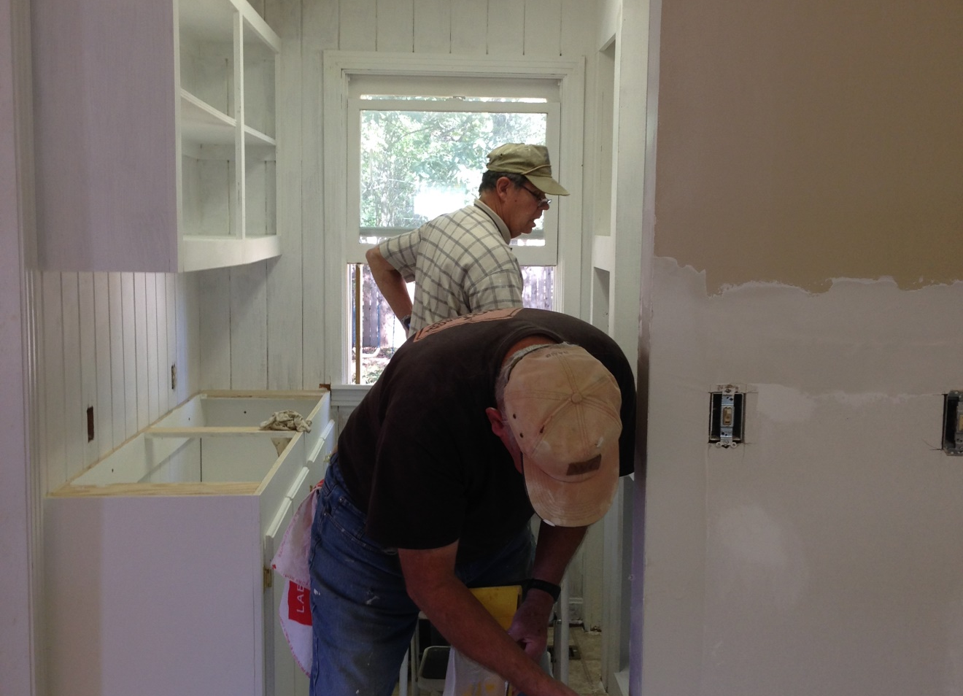

Slide 43
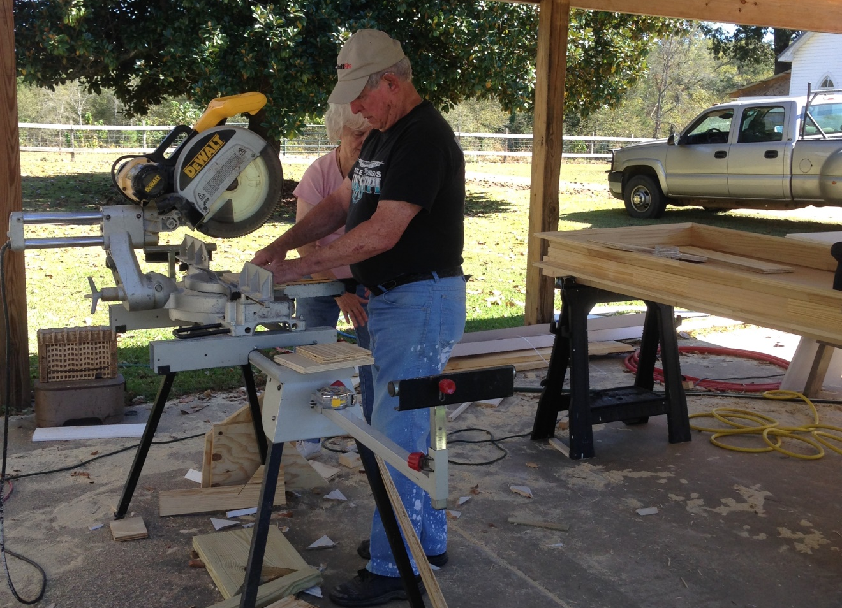

Slide 44
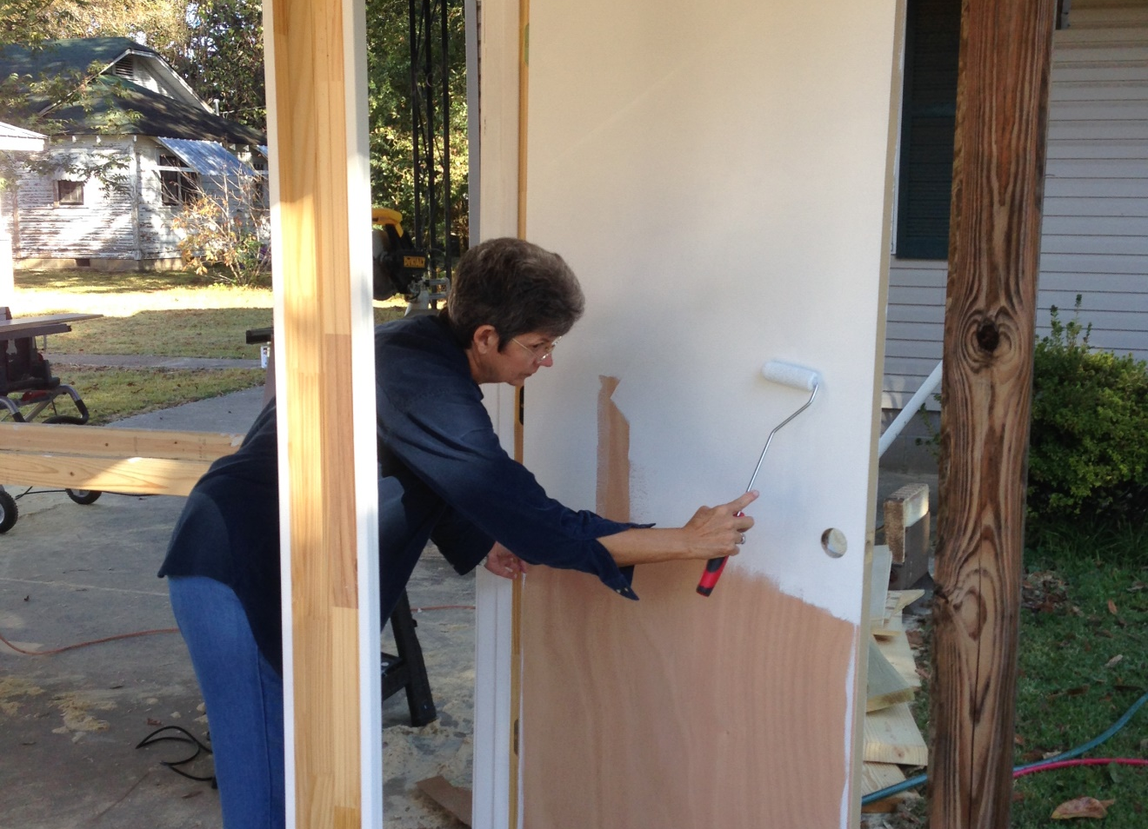

Slide 45
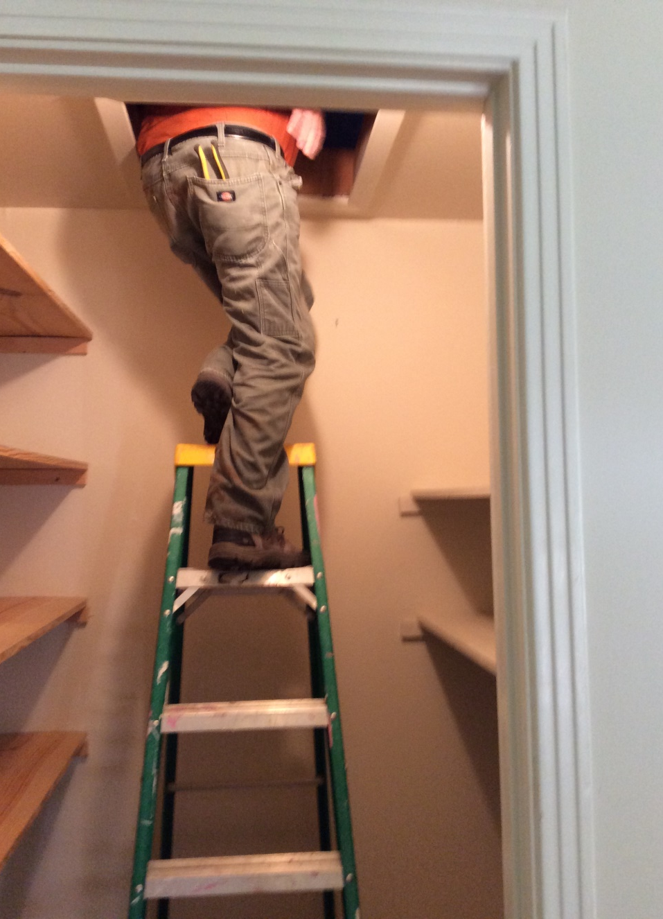

Slide 46
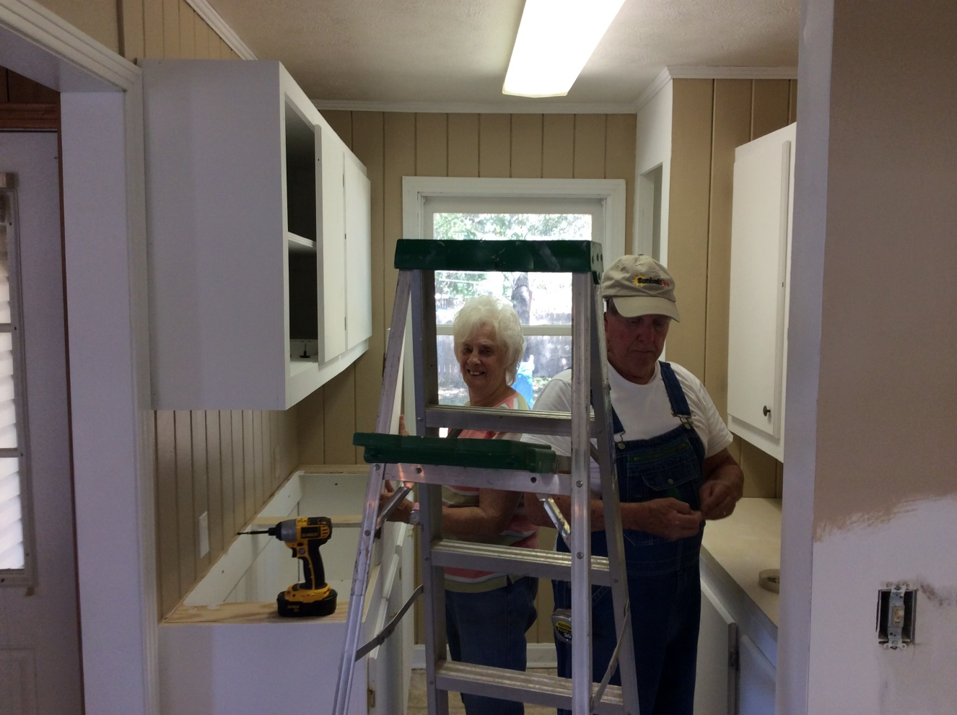

Slide 47
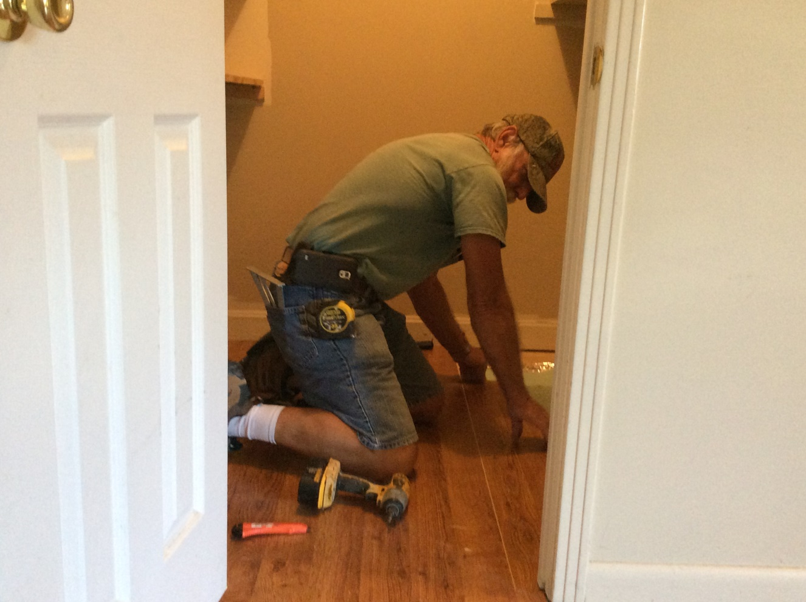

Slide 48
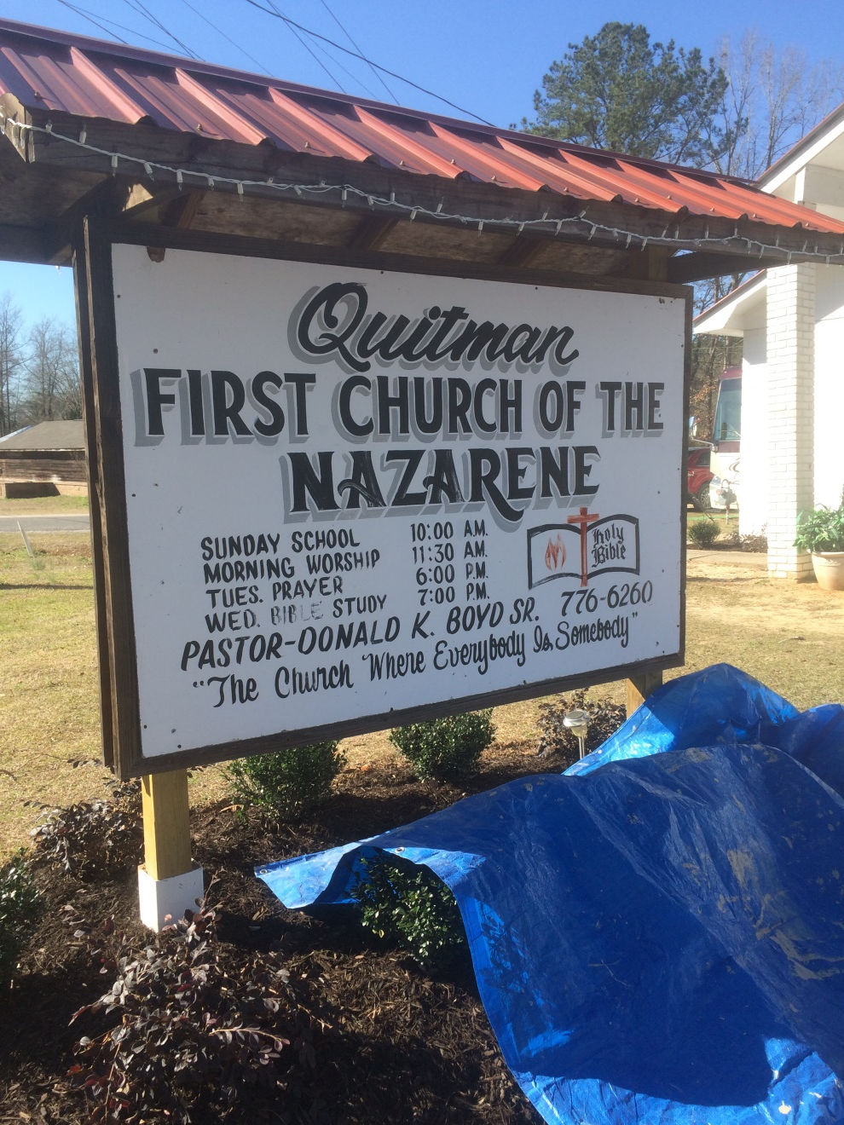
First Church of the Nazarene,
Quitman MS
February 2016

Slide 49
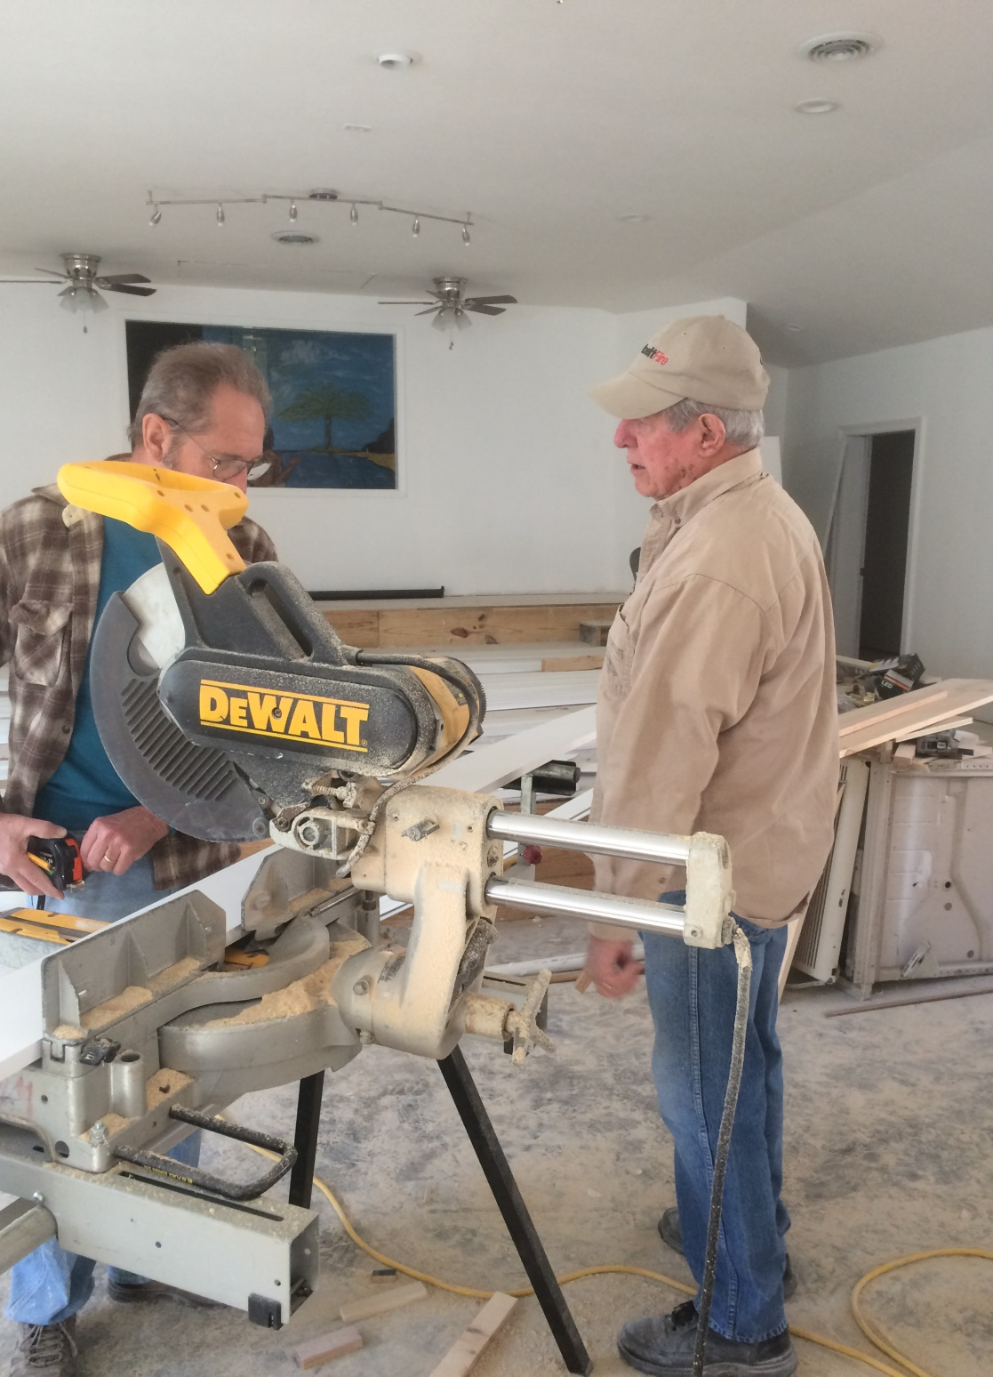

Slide 50
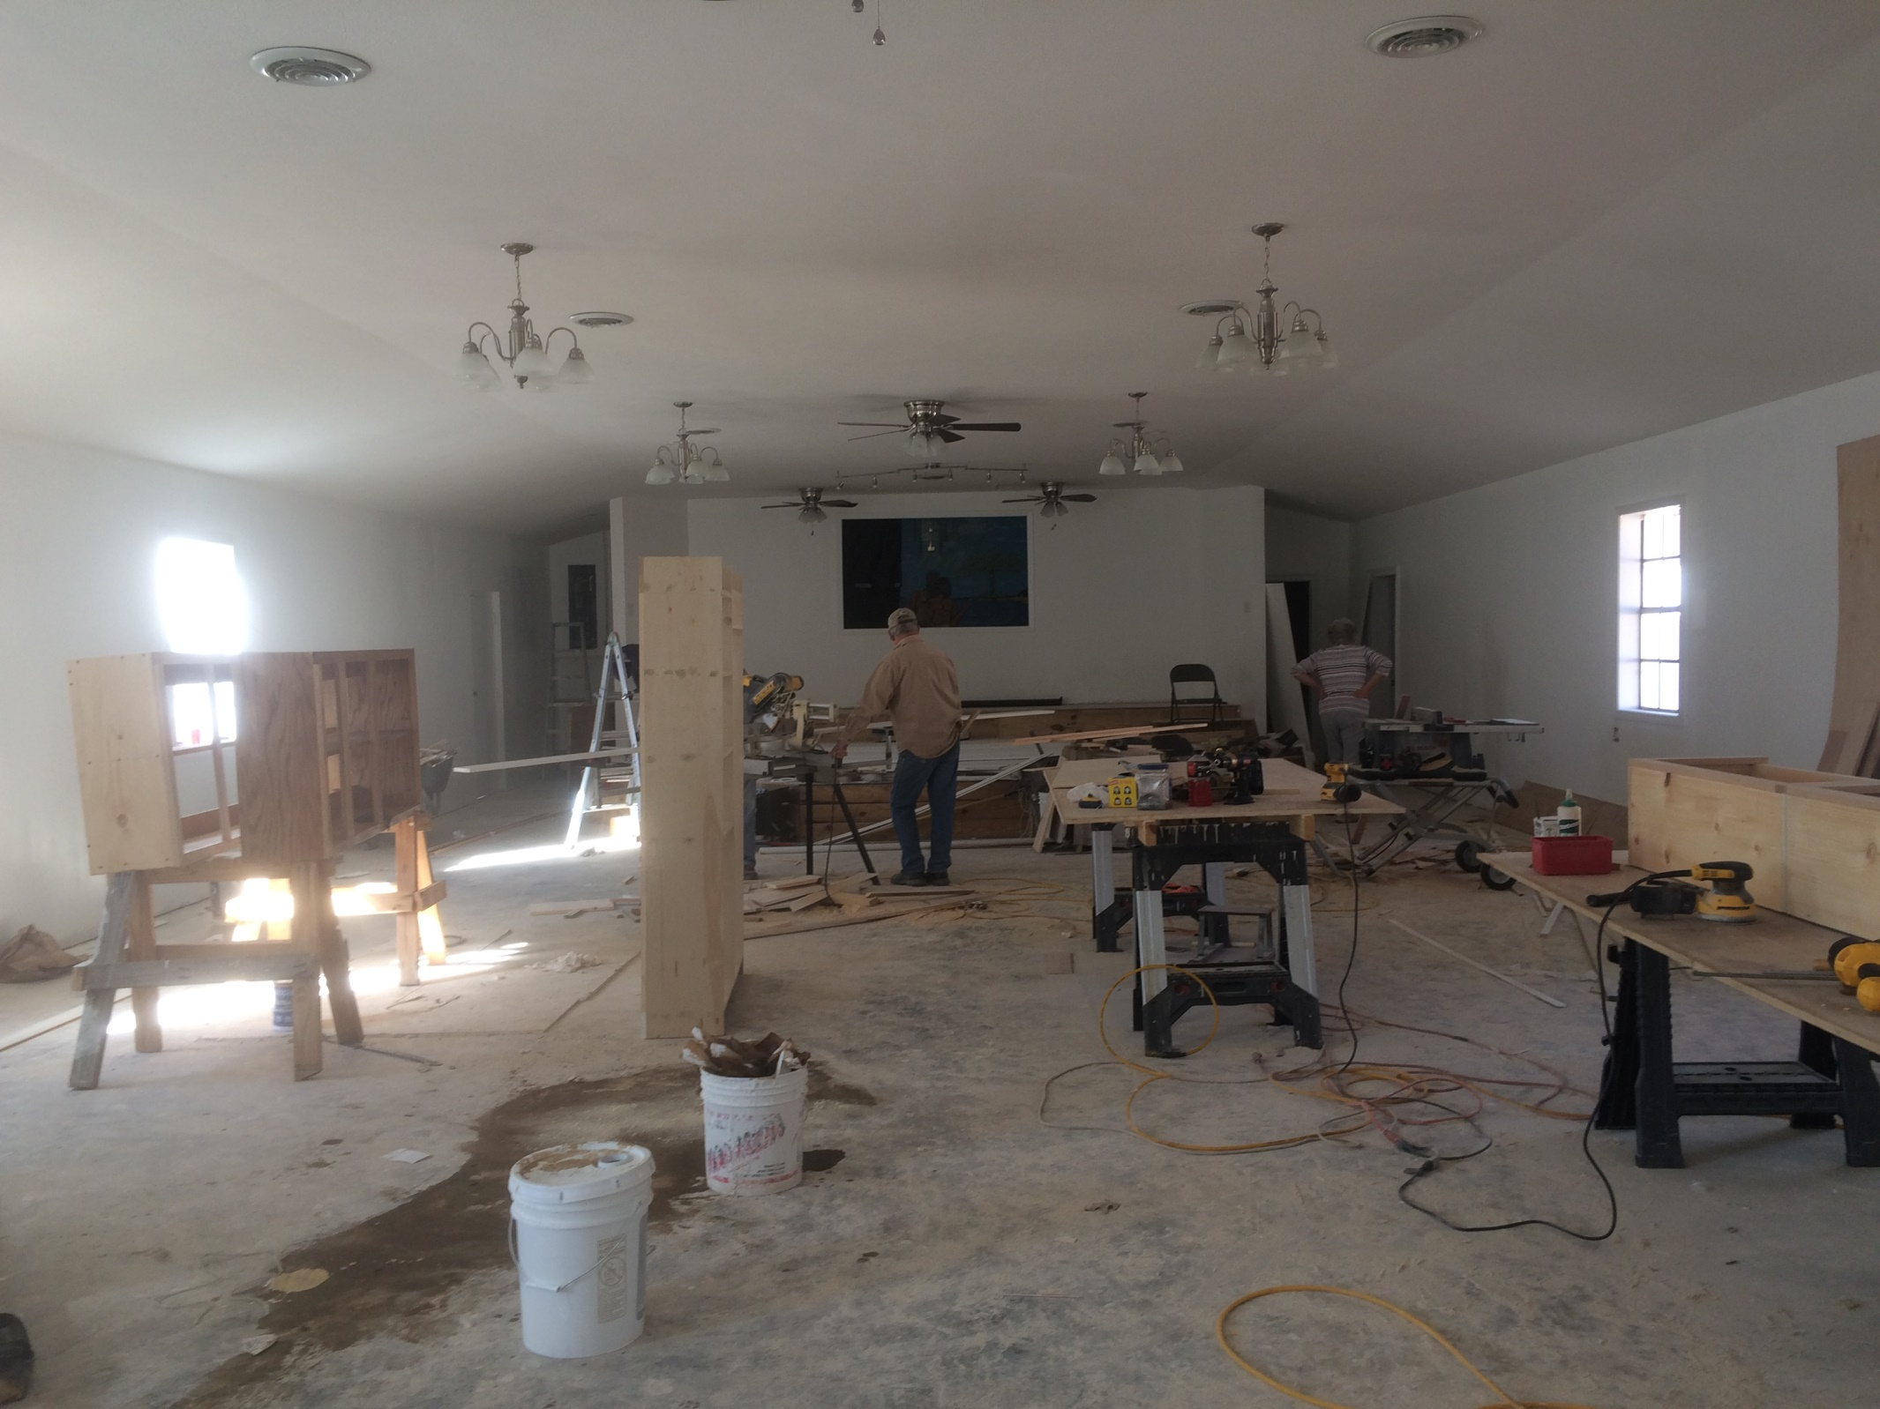

Slide 51
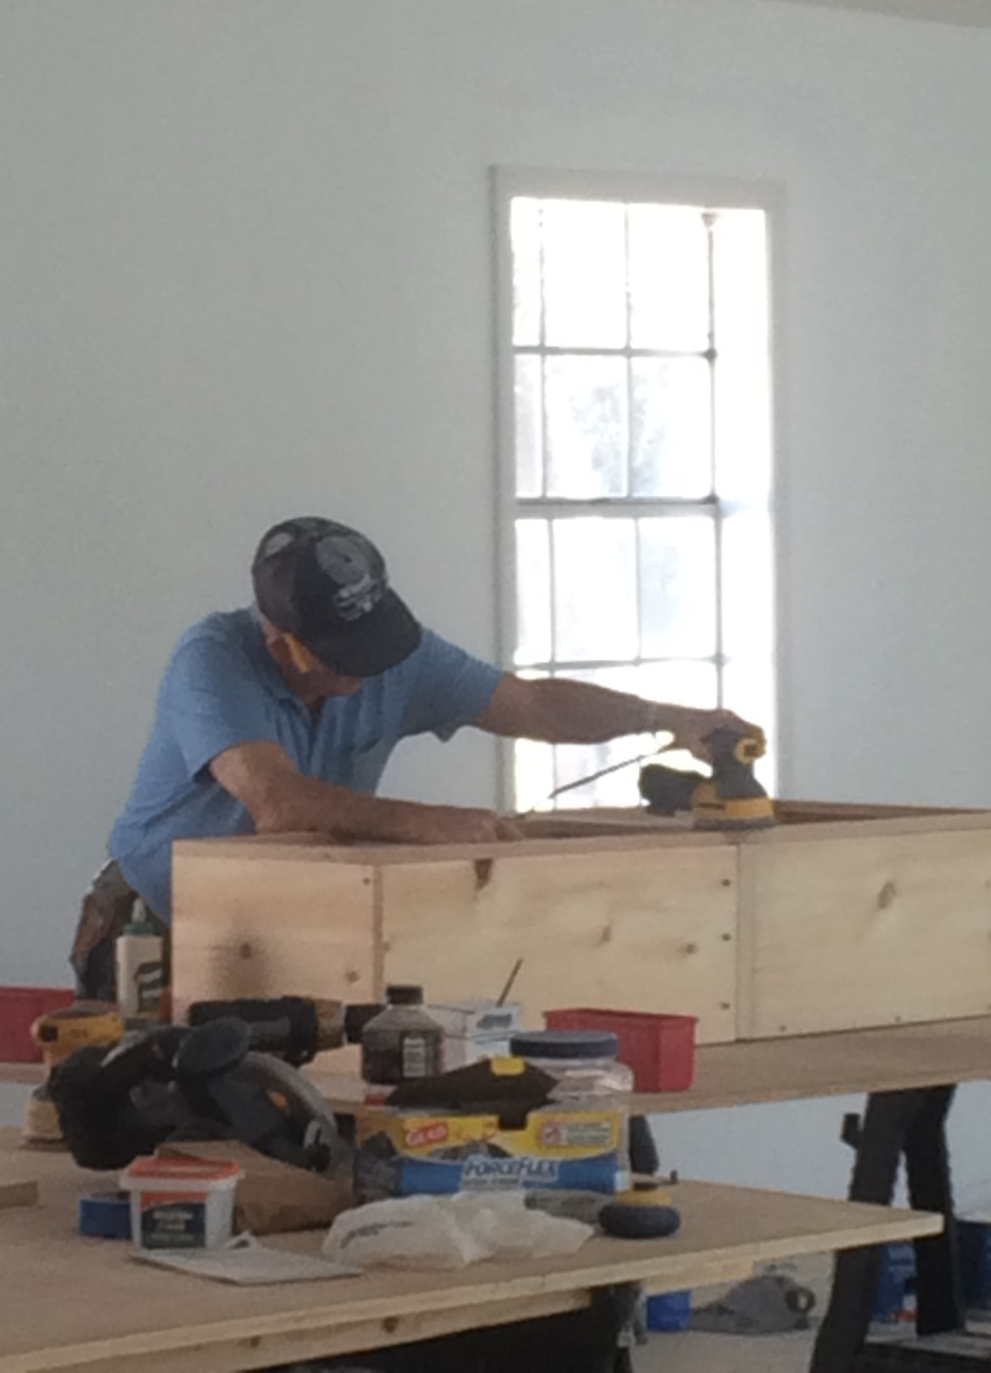

Slide 52
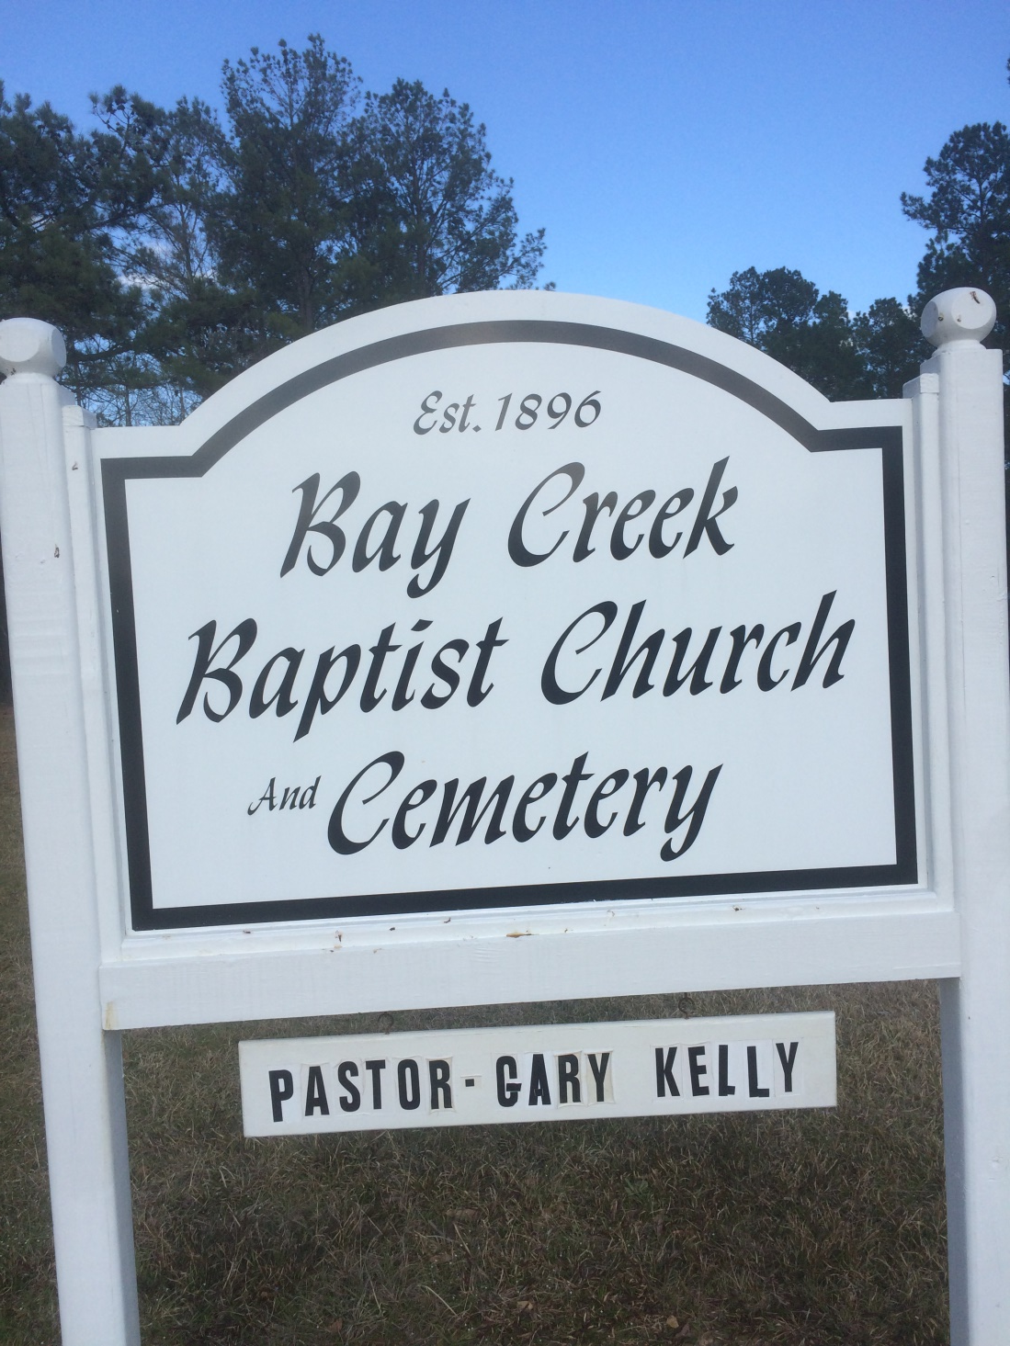
Bay Creek baptist church, lumberton, ms
February and April 2016

Slide 53
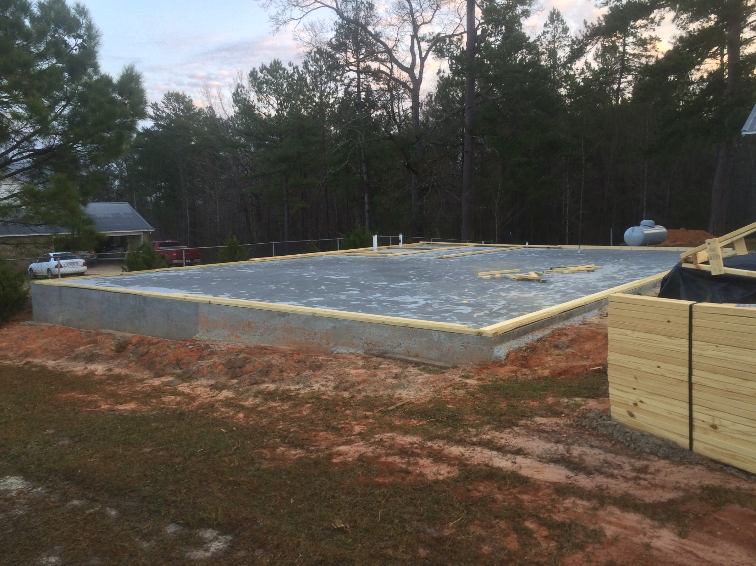

Slide 54
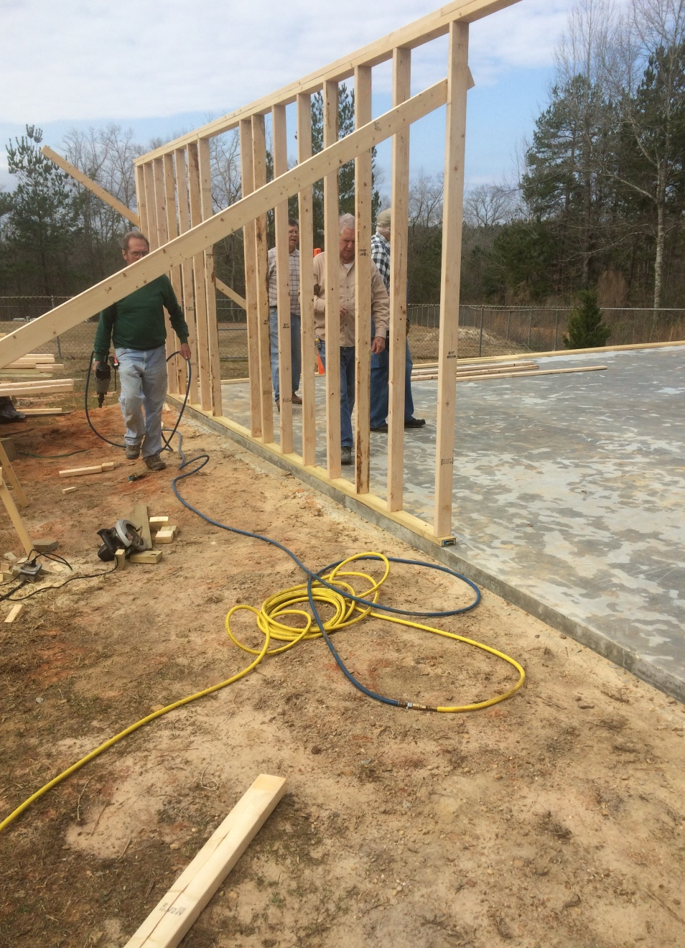
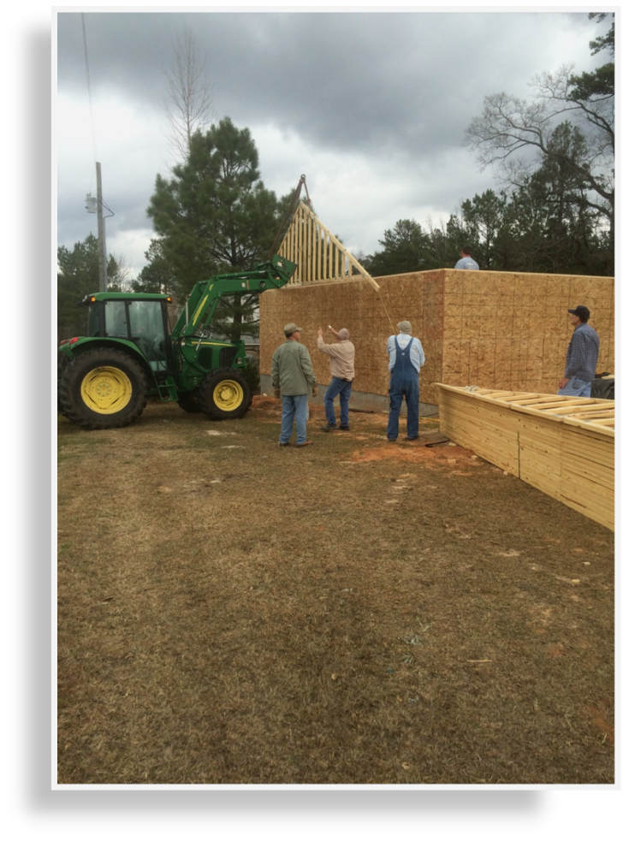

Slide 55



Slide 56

Salem Baptist Church
Carthage, MS
April 2016

Slide 57


Slide 58


Slide 59


Slide 60


Slide 61


Slide 62


Slide 63


Slide 64


Slide 65

Central Hills Baptist Retreat
April 2016

Slide 66


Slide 67


Slide 68

SUNSET AT CENTRAL HILLS

Slide 69
THE Mission, west point, ms
July 2017 and
July 2018

Slide 70



Slide 71


Slide 72


Slide 73



Slide 74


Slide 75


Slide 76


Slide 77


Slide 78

FIRST BAPTIST CHURCH,
BILLINGS, MISSOURI
August 2017

Slide 79


Slide 80


Slide 81


Slide 82


Slide 83


Slide 84


Slide 85
Mission hope, winona, ms
2017

Slide 86



Slide 87



Slide 88

UNA CHURCH,
UNA, ms
2021 AND 2022

Slide 89



Slide 90


Slide 91



Slide 92
NEWTON, MS PROJECT
2021-2022

Slide 93


Slide 94


Slide 95


Slide 96


Slide 97



Slide 98



Slide 99


Slide 100


Slide 101

Mission on the hill, west point, ms
APRIL 2022

Slide 102



Slide 103



Slide 104



Slide 105


Slide 106
SWEETWATER
MAY 2022

Slide 107



Slide 108



Slide 109

HURRICANE CHURCH
JUNE 2022

Slide 110


Slide 111


Slide 112


Slide 113


Slide 114


Slide 115


Slide 116



Slide 117


Slide 118
STARKVILLE, MS
SHOP WORK
AUGUST 2022

Slide 119



Slide 120


Slide 121



Slide 122


Slide 123


Slide 124


Slide 125

August 2022

